Slide 2
The Two Hour Job Search
Steve Dalton is a senior career consultant and career programming director for the full-time MBA program at Duke University’s Fuqua School of Business. He holds his own MBA from the same institution and a chemical engineering degree from Case Western Reserve University. Prior to entering the career services industry, Dalton was an associate marketing manager at General Mills and a strategy consultant at A.T. Kearney.
Used at over 20 MBA schools globally: Duke, William & Mary, Berkley, UCLA, Yale, Rice and more
Download the FREE LAMP list template at www.2hourjobsearch.com/resources

Slide 3
What is the Two Hour Job Search?
An Ultra specific process for using technology to find the right job fast
Strategy to tap the hidden job market
Pareto Principle: 80% of results comes from 20% of effort
Choose what you want to do
Write resume, linked in….
Prioritize target employers
Contact target employers
Recruit advocates to provide internal referrals
Interview
Select an offer
The 2 Hour
Job Search
“The 2-Hours refers to how long I would spend job searching if you told me I had to start looking for a job right now — after two hours, I’d be done for the day, since any less time would be insufficient and any more, unnecessary.”
Steve Dalton

Slide 4
What Happens in 2 Hours?
Step 3: Recruit Boosters & Advocates
Step 1: Prioritize Companies
Step 2: Find Contacts & Employees
70 min
50 min
Ongoing 3B7 Routine
Workshop 1: July 22, noon
Identify and prioritize your
top 40 Target Employers,
leave with your LAMP list
Workshop 2: July 28, 9 am
Reach out to your top 5
employers, put the 3B7
process in place, begin
developing boosters

Slide 5
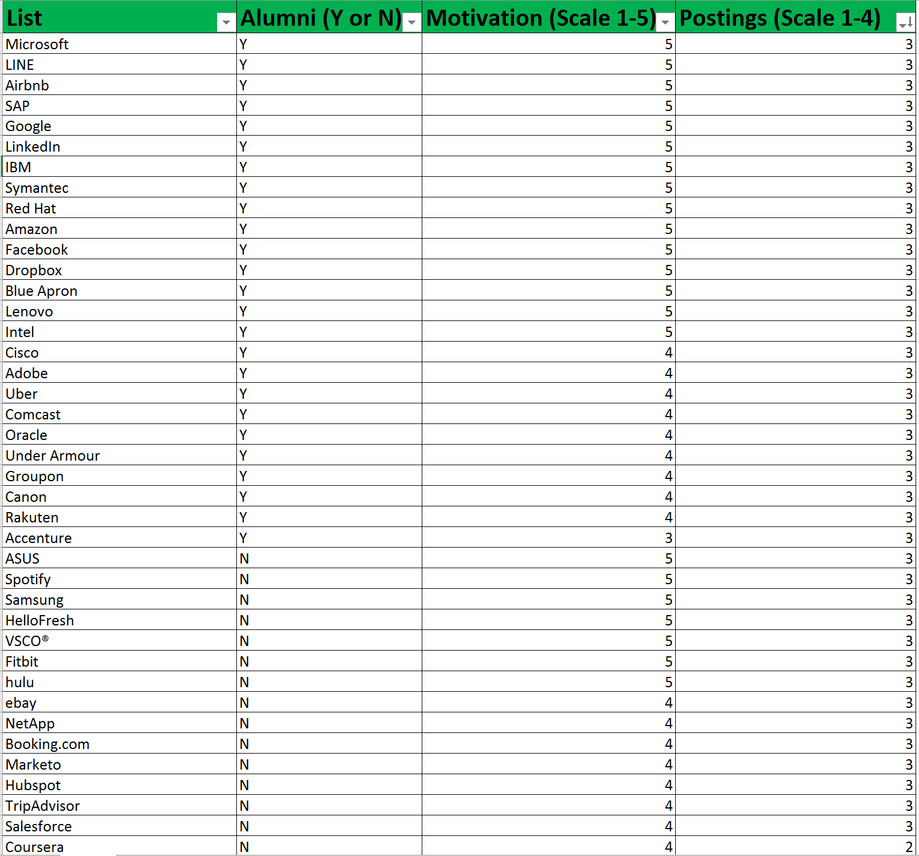
Step 1 Goal: Prioritized List
70 min
LAMP Method:
L List (Column A)
A Alumni (Column B)
M Motivation (Column C)
P Postings (Column D)
40 Companies
Excel Spreadsheet
Or download template
https://2hourjobsearch.com/resources

Slide 6
Why 40 Companies?
While companies with >100 employees first come to mind, they comprise only 36.2% of jobs and 1.3% of employers
Companies with <100 employees comprise 62.6% of jobs and 86.4% of employers
Starting with less than 40 companies skews your search toward obvious, high profile organizations, that draw lots of competition for jobs resulting longer recruiting processes.
% of employers
% of jobs
2018 data, source: http://youreconomy.org/profile/index.lasso

Slide 7
Why 40 Companies?
Employer Size (# employees) | Business | Jobs
Total | 16.0 million | 164.9 million
Self Employed (1) | 12.3% | 1.2%
Stage 1 (2-9) | 70.4% | 26.2%
Stage 2 (10-99) | 16.0% | 36.4%
Stage 3 (100-499) | 1.2% | 19.8%
Stage 4 (500+) | 0.1% | 16.4%
While companies with >100 employees first come to mind, they comprise only 36.2% of jobs and 1.3% of employers
Companies with <100 employees comprise 62.6% of jobs and 86.4% of employers
Starting with less than 40 companies skews your search toward obvious, high profile organizations, that draw lots of competition for jobs resulting longer recruiting processes.
2018 data, source: http://youreconomy.org/profile/index.lasso
Take a Broader View of the Job Market

Slide 8
List (Column A)
GROUP | BENEFITS | BEST FOR JOB SEEKERS WHO ARE….
Dream Employers | Intuitive; research is applicable to multiple employers | Targeting a specific industry sector, or location
Alumni ( or affinity) employers | Have contacts at every target employer | Targeting a specific role/ job title or location, undecided about career, introvert
Actively hiring employers | Target employers are currently hiring | Targeting a specific role/job title or location
Trending employers | Learn about industry while researching; locate less obvious employers | Switching careers, Seeking smaller employers
40 min
Target at least 10 companies in each category
40 Companies in 40 minutes

Slide 9
List (Column A)
Dream employers
Brain Dump your dream companies
From you dream employer’s LinkedIn page scroll down and look for “similar’, ‘people also viewed’, or ‘show more’ on a the right
What are common traits shared by your dream employer? Google it! “socially conscious apparel companies”
No double clicking! Capture the company and move on
40 Companies in 40 minutes

Slide 10
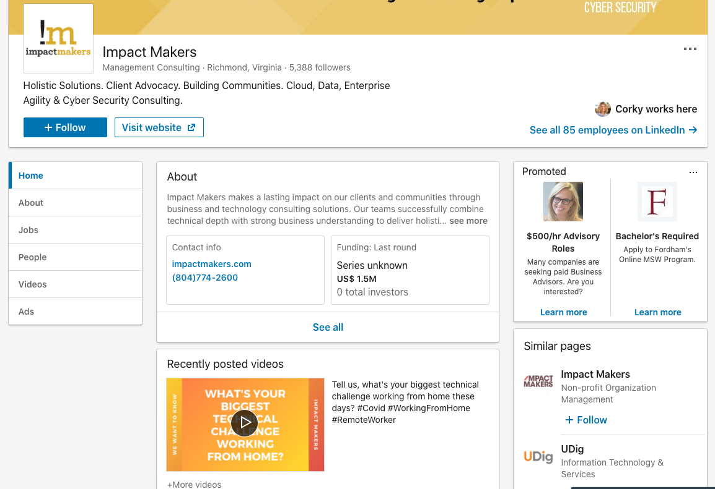
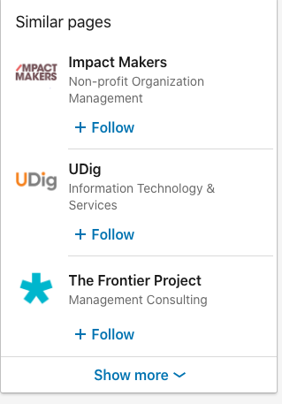
Company I searched
Similar companies found
Click here to see more
similar companies

Slide 11
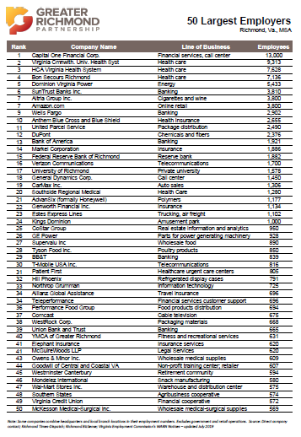

Slide 12
List (Column A)
Alumni approach
Use LinkedIn custom search: find employers hiring people like you
Search relevant job titles/positions/geographic location
Search prior employers
Search schools you attended
If your search returns too many results, enter relevant keywords (like realtor or programmer) in the job title
Search within your LinkedIn group
No double clicking! Capture the company and move on
40 Companies in 40 minutes

Slide 13
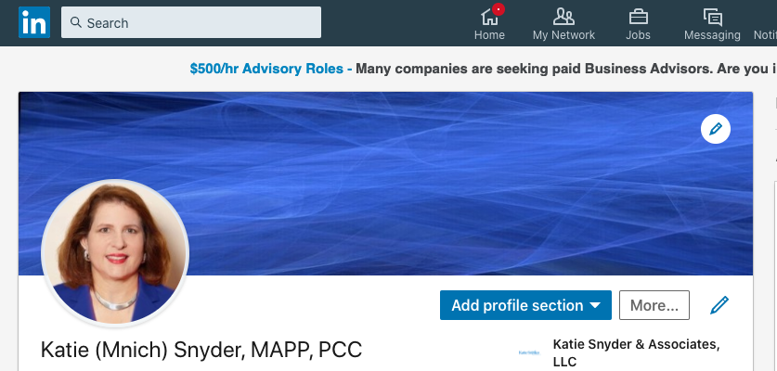

1. From your home page click in the search box
2. Click on People

Slide 14
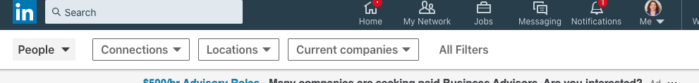
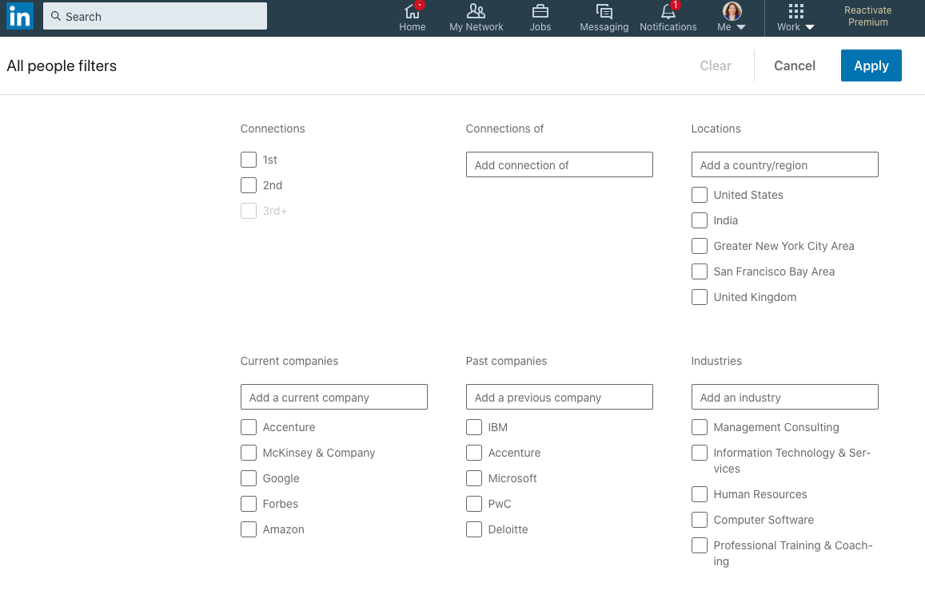
3. Click on All Filters
4. Advanced Search by school, job title etc

Slide 15
List (Column A)
Posting approach
Use indeed.com or your favorite job search engine to identify companies hiring now.
Search based on criteria important to you: geography, job type, title
Consider specialized job posting boards that interest you
B corps: https://www.bwork.com/
Non-profits: https://jobs.philanthropy.com/
Startup jobs: https://angel.co/jobs
No double clicking! Capture the company and move on
40 Companies in 40 minutes

Slide 16
List (Column A)
Trend-following approach
Google it! “gene therapy trends”
Periodicals you read: Huffpost, PC Gamer, Forbes. Who is publishing there and what companies are they representing?
RVA specific?….
No double clicking! Capture the company and move on
40 Companies in 40 minutes

Slide 17
VIRGINIA COMPANY DIRECTORIES
Chamber RVA – Member Companies (sorted by industries)
http://go.chamberrva.com/members
Commonwealth of Virginia – Central Job Board
https://jobs.agencies.virginia.gov/applicants/jsp/shared/Welcome_css.jsp
Greater Richmond Partnership (GRPVA) – 50 Largest employers in Richmond Metro
Download: https://www.grpva.com/data-reports/leading-employers/
Internet: https://www.grpva.com/data-reports/leading-employers/top-private-employers/
RVA Employers Named as Top Workplaces in 2019 (65 companies)
https://vaceos.memberclicks.net/view-all#/
Virginia Business Journal – 2020 Various Lists of Employers by Industry & Size
Excel & HTMLhttps://www.virginiabusiness.com/lists/
[A] Virginia Business Journal – 2020 Virginia’s Largest Private Companies
Excel & HTML: https://www.virginiabusiness.com/lists/?djoPage=bridge&djoPid=39986
[B] Virginia Business Journal – 2020 Virginia’s Largest Public Companies
Excel & HTML: https://www.virginiabusiness.com/lists/?djoPage=bridge&djoPid=39987
Virginia Council of CEOs (306 members)
Directory: https://vaceos.memberclicks.net/view-all#/
Virginia Economic Development Partnership – Announcements & Closings of Virginia Companies
https://vedpweb.vedp.org/announcements#/
Virginia Economic Development Partnership – Directory of International Companies in Virginia
https://internationaldirectory.vedp.org/
Virginia Economic Development Partnership – Key Industries in Virginia
https://www.vedp.org/key-industries

Slide 18
Share your List
Break out in small groups
Screen share your list within the group
Pick up ideas to add to YOUR list

Slide 19
Alumni (Column B)
For each company, identify someone who is a likely sympathetic contact.
Use LinkedIn to search for “alumni”
Type “Y” if you identify someone with these common links
Type “N” if you do not
You don’t have to know these “alumni”
Don’t get caught up in capturing additional info, it can be non-productive.
10 min
ID People with common ties in 10 minutes

Slide 20
Motivation (Column C)
Score each employer on a scale from 0-3
3= highly motivated (“dream employers”)
2 = mid-tier
1 = less preferred
0 = completely unfamiliar
Efficiency is key- DON’T spend time researching companies now
5 min
Your Gut Priority in 5 minutes

Slide 21
Postings (Column D)
Indeed.com, LinkedIn, Glassdoor-search for job postings at your target company.
Score each company on a scale of 1-3
1 = no job postings. Period.
2 = job postings, but not in your field of interest
3 = job postings, ideal, in your field of interest
NO double clicking! Read the postings later
15 min
Gauge Hiring Activity in 15 minutes

Slide 22
Step 1 Goal: Prioritized List
LAMP List Sort:
1. Motivation, 3’s on top
2. Postings, 3’s on top
3. Alumni, Y on top
Complete in 70 minutes!

Slide 23
What Happens in 2 Hours?
Step 3: Recruit Boosters & Advocates
Step 1: Prioritize Companies
Step 2: Find Contacts & Employees
70 min
50 min
Ongoing 3B7 Routine
Workshop 1: July 22, noon
Identify and prioritize your
top 40 Target Employers,
leave with your LAMP list
Workshop 2: July 28, 9 am
Reach out to your top 5
employers, put the 3B7
process in place, begin
developing boosters
Bring your LAMP list!

Slide 24
Thank you and see you next Tuesday for Workshop #2
Career Prospectors will post todays charts

