Slide 1
Telling Your Accomplishments Through S.O.A.R.
Paul Tiernan · paul.tiernan@live.com

Slide 2
Your stories must:
Appeal to your target audience
Demonstrate knowledge and skill
Make yourself standout
Tell what you accomplished and to do the same for your target audience
Notes:
Stories are Sales Tactics

Slide 3
These Acronyms are Formats
SOAR
  Situation, Obstacle, Action, Results
STAR
  Situation, Task, Action, Results
CAR
  Challenge, Action, Results
Notes:
This is a format to tell your story. This format helps you tell your accomplishment in a way that is easy for someone to understand, To make sure all the details are covered, and so you don’t forget anything. If they ask a question that you don’t have a prepared story for, put your answer in this framework.
Having good SOAR stories separate you from just being a commodity.
Story of Carilion Hospital

Slide 4
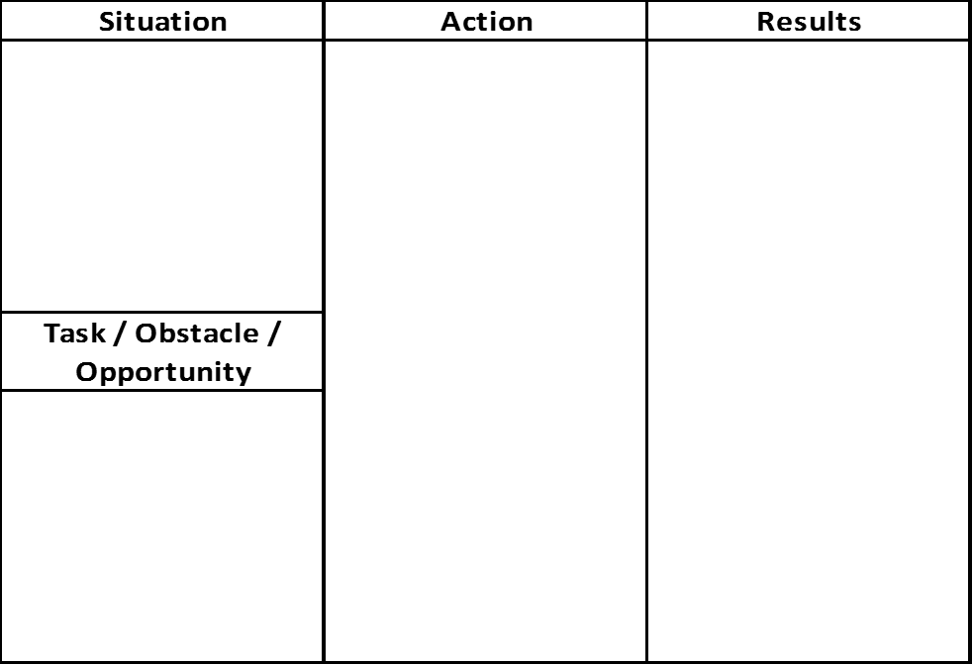
Notes:
This is a typical format used by interviewers.
There is usually, a score for each question, asking how well the question was answered. They total up the scores and those candidates with the highest scores move to the next round.

Slide 5
Composing a story with S.O.A.R.
Situation – Describe the situation
  “When I was the General Manager at The Tabard…”
Obstacles – What challenges or problems existed?
  “I saw high turnover in the restaurant…”
Actions – What did I do to overcome obstacles?
  “I developed recruiting strategies that brought …”
Results – What were your achievements?
  “Reduced turnover by 90%.”
Notes:
Putting your story in this format makes it easy for others to follow and for you not to forget parts of the story. I am always amazed in interviews where candidates don’t tell the results or spend too much time describing the situation. The action and results are most important, situation is least important.
In Results, see the period after 90%. That means stop talking, silence is good in an interview. Give them a chance to finish writing.

Slide 6
More options for your story
Task – What was assigned to you?
  “I evaluated an RFP for an agency involving …”
Opportunity – What did you see?
  “I saw new business in HR consulting & administrative services …”
  Problem – What was issue the you solved?
  “Technical skills needed improvement, so I implemented …”
  Challenge – What was the challenge you saw?
Notes:
Task is just what was assigned to you.
Opportunity, Problem and Challenge are similar, your attitude changes as you look at an issue that is causing you pain and the solution.
For Challenge and Circumstances, how did you get around the obstacle, how did you realize, reframe and what resources did you use?

Slide 7
Add depth to your stories
Realization – How did you find out what was missing?
Reframe – What perspectives did you look at the obstacle from?
  Resources – What resources did you use or acquire?
  Endgame – What is the new process going forward?
  Learn – What did you learn from this?
Notes:
These are some questions to ask yourself to add depth to your stories.
Add details to your stories.

Slide 8
Details
  Put stories in the Language of Business
  $ Money
  % Percentages
  Quantity, quality & productivity
  Additional revenue
  Reduced cost
  Ask “so what?” – Is it relevant?
Notes:
There are times people will tell a story, but it doesn’t mean anything.

Slide 9
Use on resumes
Tell how you solved or improved something and promise to do the same for someone else
People scan resumes, they don’t read them
Start with Results
  “Won BCA a $24 million 5 year contract …”
Merge Tasks and Actions
  “… by creating technical and cost proposals for a supplemental benefits program, for a 4,500 employee government agency.”
Notes:
At least 2 lines on a resume, no more than 4.
Write like Ernest Hemingway not David Baldacci.
Show what you can do for an employer, not how you do it.

Slide 10
Stand out with Accomplishments
Lead with attitude
Use words that describe action and accomplishment:
  Achieved…
  Balanced…
  Created…
  Delivered…
  Directed…
  Established…
  Generated…
  Launched…
Notes:
These sound exciting, and they jump out at people.
Attitude determines success
Attitude determines personal compatibility with interviewer or reader
Employers don’t want to know what you did in the past , they want to know how you can help them succeed in the future. It’s very hard to draw accomplishments out of people, make it easy for people and tell them.
Questions for your accomplishments are asked many ways including introductions, phone interviews, case studies and in person interviews. Such as situational, behavioral, panel – all they want to know is “Can your past accomplishments help them.”

Slide 11
Your accomplishments:
Are your greatest value to an employer
    Answer who you are as a person
    Show you are more than a commodity
  Answer the unasked questions of:
    How you got here
    Where you want to go

Slide 12
Aim Using Accomplishments
Review your accomplishments to find:
  What do I enjoy?
  What K,S,A’s am I most successful at?
  What are my strengths and weaknesses?
  What has given me most success?
Find The Really Small Center of the Bullseye
Notes:
Use your accomplishments to Aim your search.
When you know your accomplishments and know where you’ve had success, what occupations you enjoy, the industries and locations you want to work, so that you can tell others clearly and focus on the really small center of the bullseye.
When you identify your accomplishments you can see your strengths and weaknesses; from 2 perspectives, first your K,S,A’s, and, second, what gives you strength and energy, against those that exhaust and weaken you.

Slide 13
Tips for Age Bias
Be Specific
Be Passionate
Be Your Age
Be Flexibile
Notes:
Specific – talk about time you worked for a younger boss or colleague
Passionate – you have experience, younger candidates don’t, they sell enthusiasm and passion, you have to bring that.
Age – act your age, don’t dress like a millennial, don’t mimic their behavior or language
Flexibility – show your adaptable, cooperative, handle direction & feedback, help diverse teams succeed

Slide 14
Questions

