Slide 1

Preparing for the RVA Career Expo
Jon Thurmond, SHRM-SCP

Slide 2


Welcome! Who is this guy?
Jon Thurmond is the Mid-Atlantic Regional Human Resources Manager for Team Fishel, a utility engineering and construction firm. His experience includes working in the construction, public utility, healthcare, and accounting & finance industries, in roles encompassing Employee/Labor Relations, Recruiting, Training, and HR leadership.
Outside of work, Jon hosts the #HRSocialHour Half Hour Podcast and Twitter chat. He serves as the Social Media Director for the Virginia SHRM State Council and is a member of the Capital Region Workforce Development Board representing the greater Richmond, VA area. Jon is a nationally recognized speaker on social media recruiting, employer branding, and podcasting and consults with employers on their social recruiting efforts.
Jon holds SHRM-SCP certification, a Labor Relations-Contract Administration certificate from Cornell University, a Master’s in Music Education from the University of Kansas, and a Bachelor’s in Music Education from Middle Tennessee State University. He is also a Hootsuite Certified Professional.
Jon is a 2 time Career Prospectors/JAM alumni.

Slide 3
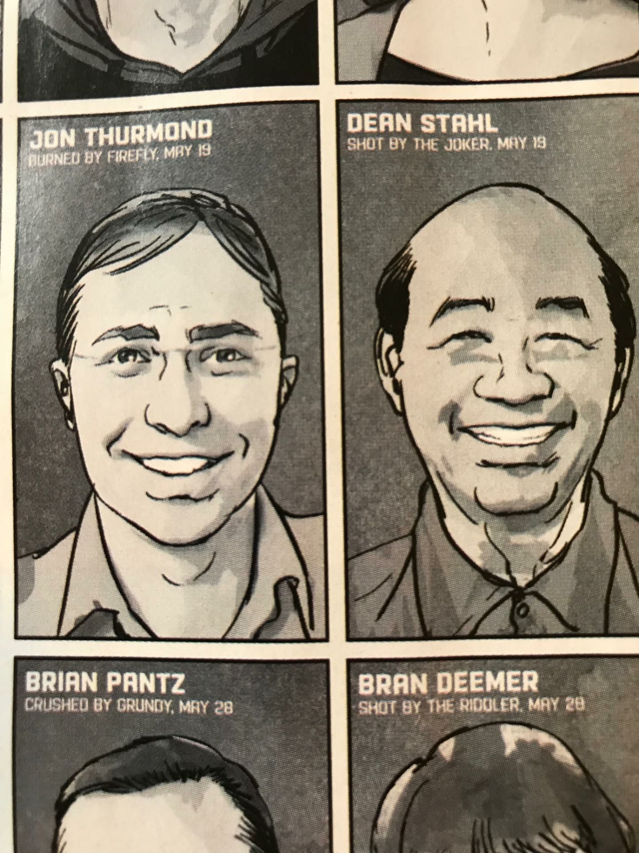
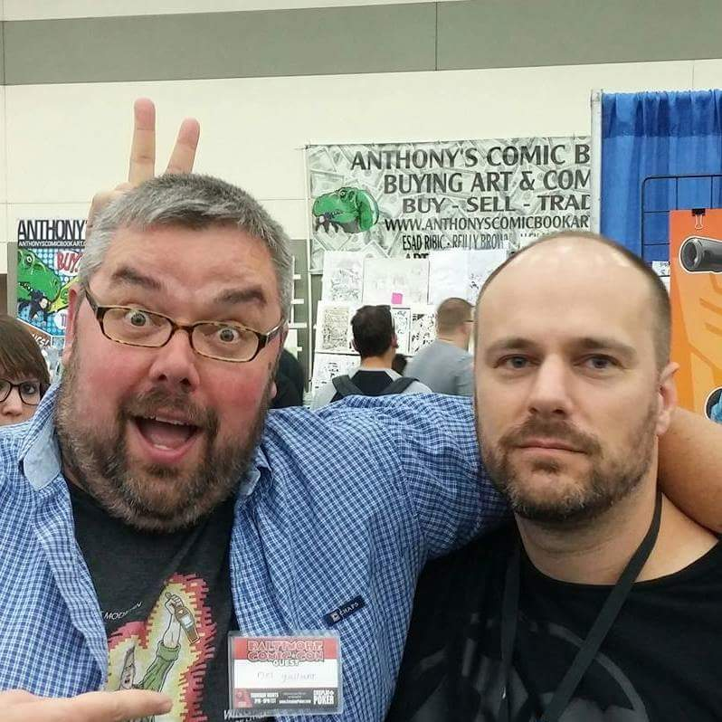
Why am I showing you these pictures?

Slide 4

Why should you attend the Expo?
100 + employers participating, one (or more) of which may be looking for YOU
1000 + job seekers in attendance, great networking opportunities
Professional focus
Focus on relationship development

Slide 5
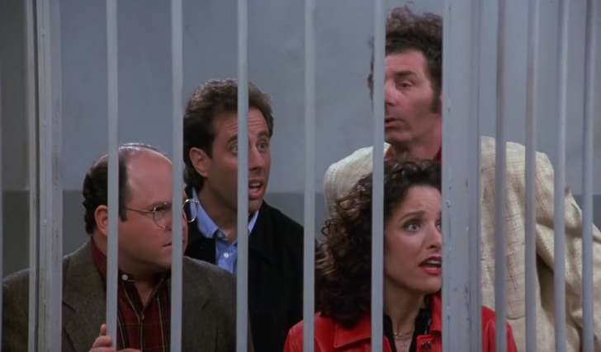
There’s no “Career Expo Jail”

Slide 6
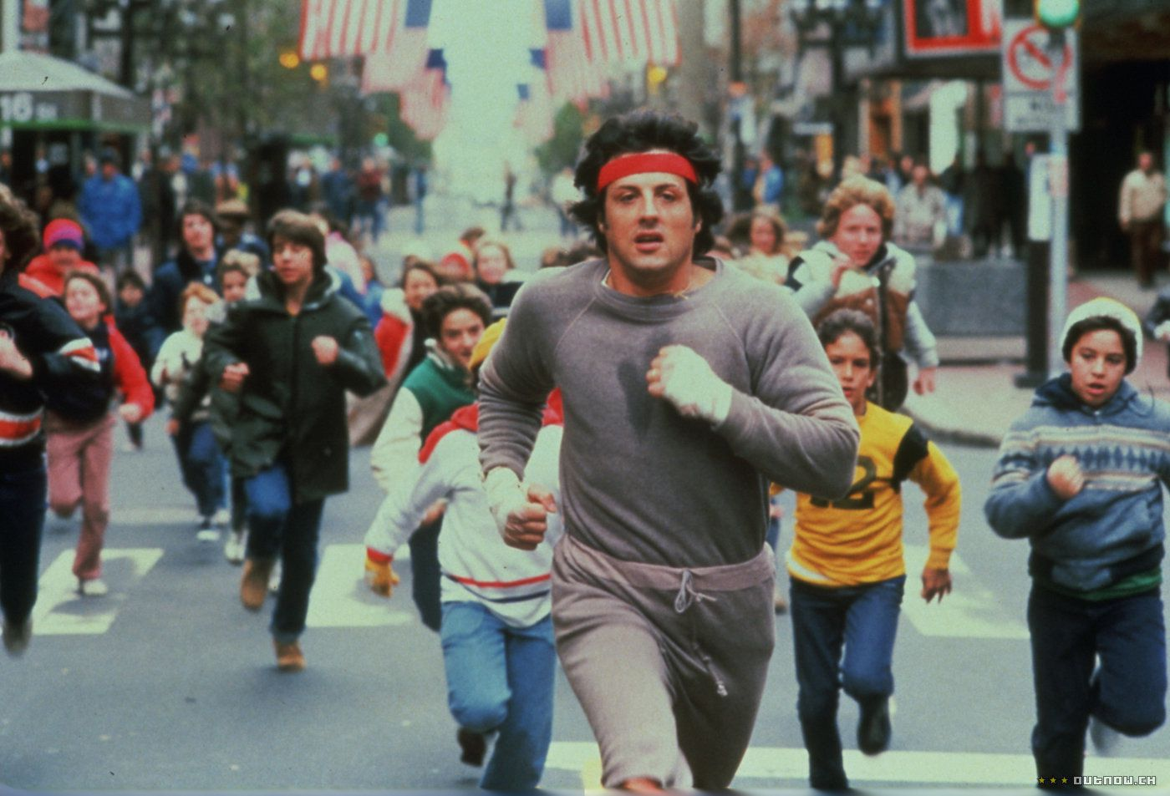
Start preparing for the Expo
Register for the Expo at richmondhokies.org
Post your résumé to the Expo database
Have business cards printed and in hand

Slide 7
A résumé don’t
QUALIFICATON HIGHLIGHTS
YEARS CALL CENTER SUPERVISOR EXPPERIENCE
YEARS CUSTOMER SERVICE EXPEREINCE
YEAR OPERATIONS EXPERIENCE
SIX SEGAM YELLOW BELT
HIPAA CERTIFIED
CERTIFIED TRAINER
SUMMARY OF QUALIFICATIONS
TAKE PERSONAL RESPONSIBILTY FOR QUALITY AND TIMELINES OF WORK AND ACHIEVE RESULTS WITH LITTLE OVERSIGHT
ADAPT TO THE CHANGES DUE TO BUSINESS NEEDS,CONDINTIONS , ALONG WITH WORK RELEATED RESPONSIBILITIES
WIDE EXPERINCE IN CALL CENTER SUPERVISON IN ALL LINES OF BUSINESSEXCELLENT SKILLS IN THE AREA OF COACHING AND DEVELOPMENT OF AGENTS
LEADERSHIP SKILLS SET OBTAINABLE GOALS ALONG WITH A TIME FRAME TO MEET THE GOALS TO ENSURE AN EXCELLENT CUSTOMER EXPERIENCE FOR OUR CONSUMERS
CONDUCT CLASSES FOR CONTACT CENTER CUSTOMER SERVICE REPRESENTATIVES. IDENTIFY PERFORMANCE ISSUES, PROVIDE CORRECTIVE ACTION AND SUGGEST TERMINATION FOR CSRs NOT MEETING PERFORMANCE FRITERIA IN THE TRAINING CLASS.

Slide 8

Researching Expo Employers
Identify target companies
Do you have any connections to employers participating?
Read up on companies (LinkedIn, Glassdoor, industry sites)
Develop questions you’d like to ask employers

Slide 9

Social Media
LinkedIn and Facebook
  Share information about the Expo (updates, groups)
  Follow companies attending of interest to you
  Post to recruiters/companies of interest attending
Twitter
  Tweet about the event! #RVACareerExpo
  Retweet companies, recruiters, fellow job seekers
  Subscribe to Employer and Volunteer lists

Slide 10
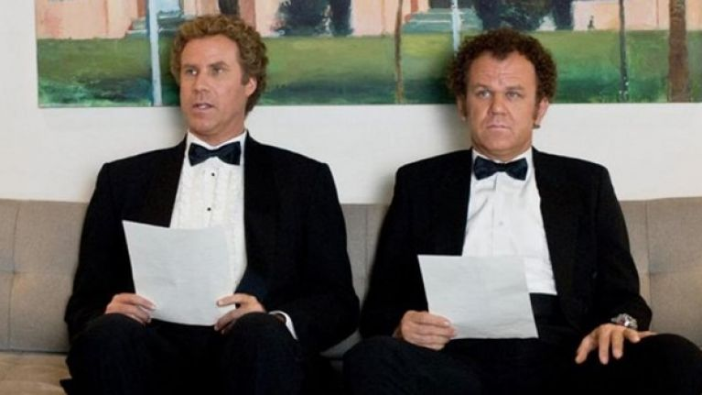
The Big Day
Have your game plan ready
Dress for success
Name tag
What should you carry?
  Folio with copies of résumé
  Pen/pencil
  Business cards

Slide 11
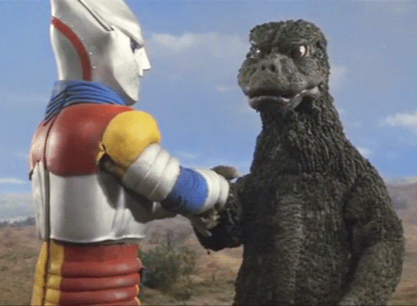
During the Expo
Solid handshake, introduction, smile, be engaged!
Recruiters meet on average 40 candidates at an event
Visit recruiters that don’t have much traffic
Talk to other candidates, introduce a peer to a recruiter
Say “thank you”

Slide 12

Don’t be a “collector”

Slide 13
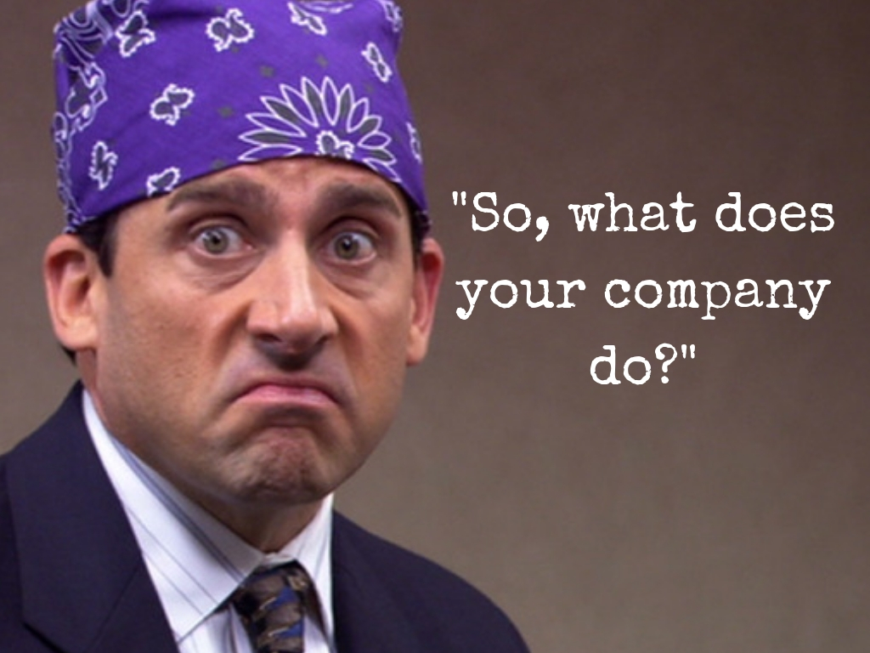

Slide 14
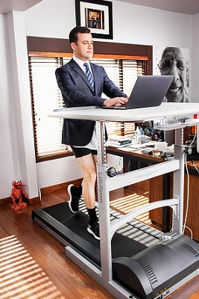
After the Expo
Follow up with employers in a few days, NOT that day unless requested
Send personalized LinkedIn invites, “Great to meet you at the Career Expo.”
Follow, tweet, and retweet Twitter users that attend
Follow employers on LinkedIn and Facebook
Take advantage of Career Prospectors/JAM offerings
NETWORK, NETWORK, NETWORK

Slide 15

Questions?

Slide 16



Thanks and good luck!
hrsocialhourpodcast.podbean.com
@jon_thurmond
linkedin.com/in/jonthurmond
jon@jonthurmond.com

