Slide 1
Gaining and Holding Informational Meetings
How to get yourself “In the drawer”
Brian Keller – Director of Sales Training
McKesson Medical
August 27, 2019

Slide 2

Meeting Objectives
What are you trying to accomplish with this meeting?
Make a new connection
Learn about a new company/industry – eliminating dead-ends
Practice your interviewing skills
Get referrals

Slide 3

Getting a meeting
Use your network for a referral
A “warm hand off” is best
An introduction works, too!
Make a phone call to arrange a time and place
Their office is best
Have several times available
Critical point – You’re not asking for a job!!!
Looking for information as part of your search
Want to learn about the industry/company

Slide 4

Prepare for Success
Resume up to date?
If not, get it right!
If so, send it before the meeting
Cover letter / email to set the stage
Thanks for your time
What you wish to talk about
Your resume
Reiterate – You’re not asking for a job!
Looking forward to our discussion

Slide 5

Meeting Preparation
Research the Industry
Research the Company
Prepare Questions
Current and future state of the industry?
Current and future state of the company?
What things are being done to maximize the business or minimize the problems?

Slide 6

What are you attempting to discover?
Problems
To which you are the solution!
Which indicate why you don’t want to work there
Opportunities
For future business with others
For business with you
For ways that you can help them

Slide 7

Meeting Day!
Dress professionally
Get to the “area” 15 minutes early
Be exactly on time to your appointment
Bring 2 copies of your resume, business cards, something with which to take notes

Slide 8

The Meeting
Introductions
Take Charge!
Thanks for the time
Lay out the agenda – discovery is your goal
Promise not to ask for a job
Ask if that sounds okay with them
What if it isn’t?

Slide 9
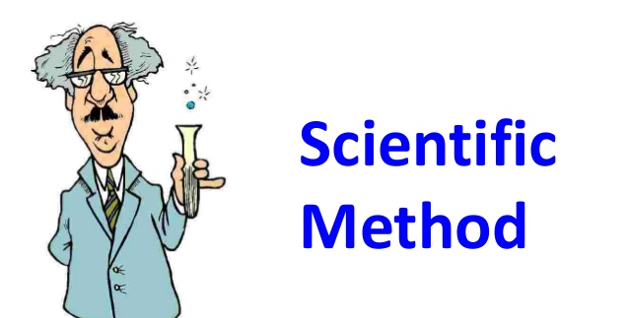
Run the Meeting
Elevator Speech
Get industry overview
Use your prepared questions
Get company overview
Is this company typical of others in the industry?
Resume review
What one thing stood out? Why?
What positions am I qualified for in this industry?
How would you suggest I go about securing one of those?

Slide 10

The Wrap Up
When the time you secured is up, ask how they are on time
Start collecting your things
“Who else do you recommend I meet?”
Thanks again for the time
“May I contact you again?”

Slide 11

Follow Up!
Thank you note vs email
Reminder that you’re still in the search
Ask for referrals

Slide 12
What questions do you have?
Brian.G.Keller@gmail.com
www.linkedin.com/in/briangkeller

