Slide 1
Henrico Economic Update
July 13, 2020
CP
Come for Success.
Stay for Life.

Slide 2
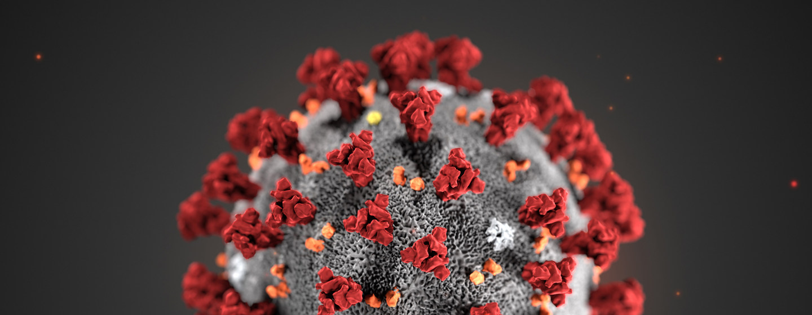
Coronavirus in Henrico
2,891 positive cases
173 fatalities (6%)
Hospitalizations average ~10%
All but 19 fatalities are in nursing home facilities* as of June

Slide 3

Henrico EDA Response
1,700+ businesses reached (so far)
Business resources on henrico.com
Delay on tax payments:
  Real estate -- Machinery & Tools
  Personal property -- Sales
  Transient Occupancy (hotel)
LISC/CDBG $300K microloan program
$2M deposit to Virginia Community Capital
Good News Now

Slide 4
Travel
95% of Americans planned to stay home for Memorial Day weekend (The Harris Poll)
AAA did not issue a Memorial Day travel forecast for the first time in 20 years.
On Friday, 5/22, the TSA screened under 350K air passengers, just 12.4% of the almost 2.8M passengers screened on the same day in 2019.
Hotel Occupancy
 | April – May 2019 | April – May 2020
Richmond MSA | 68% | 31%
Virginia | 68% | 28%
USA | 70% | 28%

Slide 5
Travel
 | SENTIMENT OF CENTRAL VIRGINIA
65% | plan to avoid traveling themselves until COVID blows over
51% | don’t want visitors
34% | are comfortable with family and friends visiting
28% | feel comfortable going to in their community
37% | feel neutral about seeing tourism advertising

Slide 6
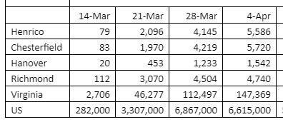
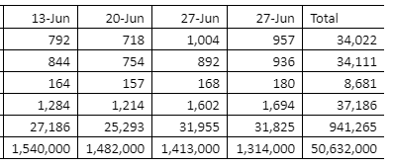
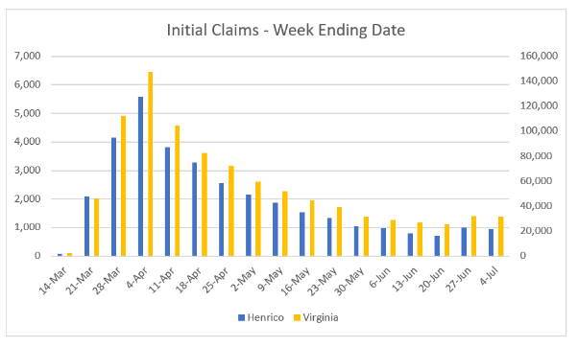
Unemployment
Henrico unemployment
34,022 initial claims filed, 19.9% of the working population

Slide 7

What’s Next
Tom Barkin,
Richmond Fed President
Down the elevator
Up the stairs
(no V-shaped recover)
Good news, we’ve hit the bottom
“Now is not the end. It’s not the beginning of the end, but it is, perhaps, the end of the beginning.”
-Churchill

Slide 8

Recovery | A New Tomorrow
Henrico EDA managing 49 active projects
Development activity very strong
Staying in Phase 3 until either a treatment or a vaccine

Slide 9
 | Hiring
ASGN | Fortune 1000 IT HQ coming from California
Topgolf | topgolf.com/careers Hospitality, restaurant, bar, dishwasher
Cabela’s | https://www.cabelas.com/shop/en/career-opportunities customer service, boats, firearms
Genetworx | recruiting@laborocity.com Lab, registration, shipping & receiving
PDI | pdicorp.com/careers Assembler, winder, material handler
SimpliSafe | https://careers.simplisafe.com/ Call center
TemperPack | https://www.temperpack.com/careers/ HQ, manufacturing, exporting
Henrico EDA | https://www.henrico.com/about-us/careers Business Manager
PPD | https://www.ppd.com/careers/ Scientific, Lab, Rx R&D

Slide 10




Felicia Ainsa, Business Manager
felicia@henrico.com | 804.501.7522
Visit us at:
www.Henrico.com

