Slide 1
interview skills Using Rapid Transformational Therapy Anne M. Wrinn

Slide 2
THIS TALK IS NOT A LIST OF INTERVIEW SKILLS OR TECHNIQUES. WE WILL EXPLORE YOUR FEARS
ABOUT INTERVIEWING SO THAT WE CAN CREATE A SOUND FILE TO OFFSET YOUR FEARS.

Slide 3
OBSTACLES TO HAVING A GREAT INTERVIEW
What are your fears?

Slide 4
If you’re searching for that one person to change your life, look in the mirror.
Unknown

Slide 5
The subconscious brain occupies 83 percent (about five-sixths) of total brain mass and controls 96 to 98 percent of perception and behavior.
From Assaraf, John and Murray Smith. The Answer, p 48.

Slide 6
Those strategies are steps we can take using our conscious mind. But consider this:
The conscious brain occupies 17 percent of total brain mass (about one-sixth of the brain’s weight), yet it controls only 2 to 4 percent of actual perceptions and behavior.

Slide 7
2-4%

Slide 8
“Habits are thousands of times stronger than desires. . . It is your habits, not your desires or other conscious thoughts, that run your actions.

Slide 9
96 to 98 percent of all your behaviors are automatic.
This is why we set goals, but don’t reach them. Setting them is a function of the conscious mind. Reaching them is a function of the nonconscious mind.” John Assaraf

Slide 10
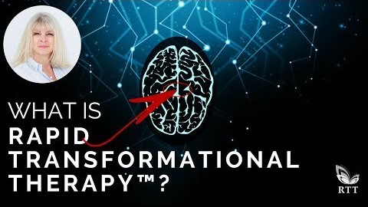

Slide 11
BEING PREPARED
RESUMES, PORTFOLIO
2. STORIES
STATE OF MIND
CLOTHES

Slide 12
THE RULES OF THE MIND
The mind learns by repetition.
The mind cannot hold conflicting thoughts.
What is expected tends to be realized.
Imagination is more powerful than knowledge when dealing with your own mind or the mind of others.
In a battle between emotion and logic emotion always wins.

Slide 13
BRAIN WAVES
DELTA – babies are at the lowest frequency. Birth to 2 years. Lowest EEG frequency,
which is at .5 to 4 cycles per second (Hz).
THETA-at 2 to 6 years of age. A highly suggestible state where they absorb cultural
norms and expectations. Hypnosis. (4-8 Hz)
ALPHA-when meditating or in the flow of an activity. Focus.
BETA-Every day, conscious mind.
GAMMA-Fastest brain waves. Processes information from different brain areas.
Any process that changes your perception changes your brain waves. When your brain waves are out of balance it results in physical and emotional abnormalities. Research scientists have correlated brainwave patterns associated with emotional and neurological conditions.

Slide 14
Your mind always does what it thinks you want it to do.
Your mind works to move you from pain to pleasure.
Your mind responds to the pictures and words you install in it.
Your mind wants to stay with what is familiar while avoiding what is unfamiliar.
Whatever you focus on you get more of.

Slide 15
11. You make your beliefs and then your beliefs make you.
12. The strongest force in all of us is that we must act in a way that consistently matches our thinking. A habit of action is caused by a thought.
13. Your thoughts form a blueprint that your mind and body work to make your reality.
What you present to your mind, your mind will present back to you.

Slide 16
Your mind does not care if what you say is good, bad, indifferent, true or false; healthy, unhealthy, right or wrong; it simply acts on your words.
Every thought you think causes a physical reaction and an emotional response.
17. When dealing with the subconscious mind the greater the conscious effort the less it responds.

Slide 17
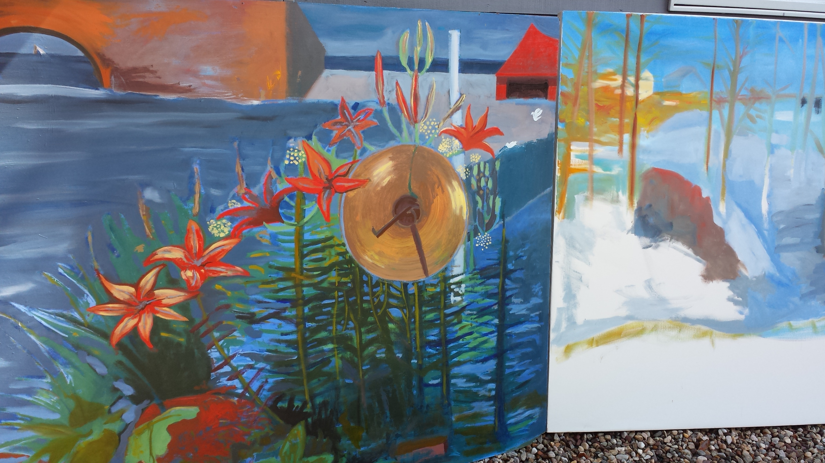
what are the pictures you paint in your head?

Slide 18
DO YOUR WORDS SUPPORT YOUR GOALS AND LIFE VISION?

Slide 19
HOW SUGGESTIBLE ARE YOU?
Let’s experiment!

Slide 20

L E M O N

Slide 21
EXPERIENTAL ASPECT

Slide 22
Marks and Spencer
IBM
Google
Penguin
Ernst and Young
Disney
Mindvalley
Conde Nast
TedX
Sky
BBC 4 and 5
Closer
Mizuho bank
Wigan Football Team
MTV
VH1
PARTIAL LIST OF ORGANIZATIONS WITH WHOM
MARISA PEER HAS WORKED
The Mastermind Agency
Bauer Media Sales Team
Business Excellence Forum and Awards
INSPIRE Conference
Be Fit Annual Event
Mind Body Spirit Festival
Supergrowth Conference
The Yes Group Speaker Series
Women in Business Superconference
Women in Banking and Finance
We are Like Minds
Hachette Publishing
St. Mary's College of Ascot
Academy of Chief Executives
Edinburgh Festival

Slide 23
Q U E S T I O N S ???

Slide 24
UPCOMING Q&A SESSIONS ON
BUSINESS TALK RADIO
FIVE THURSDAYS BEGINNING 6/25
11:00-11:30
TUNE IN AT https://businesstalkradio1.com/studio-one

Slide 25
Anne M. Wrinn
amwrinn@gmail.com
804-840-3656
Website: annewrinn.com

Slide 26
RESOURCES
Lipton, Bruce, Ph.D. The Biology of Belief.
Dispenza, Dr. Joe. Becoming Supernatural.
Marisa Peer, creator of Rapid Transformational Therapy.

Slide 27

WHAT IS RAPID TRANSFORMATIONAL THERAPY?
VIDEO: WHAT IS RAPID TRANSFORMATIONAL THERAPY
(from YouTube)
SOUND FILE:

