Slide 1

Interview Preparation

Slide 2
Agenda
Conduct company research
Attitude, physical appearance and environmental management
Answering behavioral questions
Questions to ask interviewers
Practice to build confidence and competence
Evaluating your performance post interview

Slide 3
Congratulations!
Your hard work paid off and you’ve landed an interview!
Now, you will benefit from spending several hours in preparation for your interview.

Slide 4
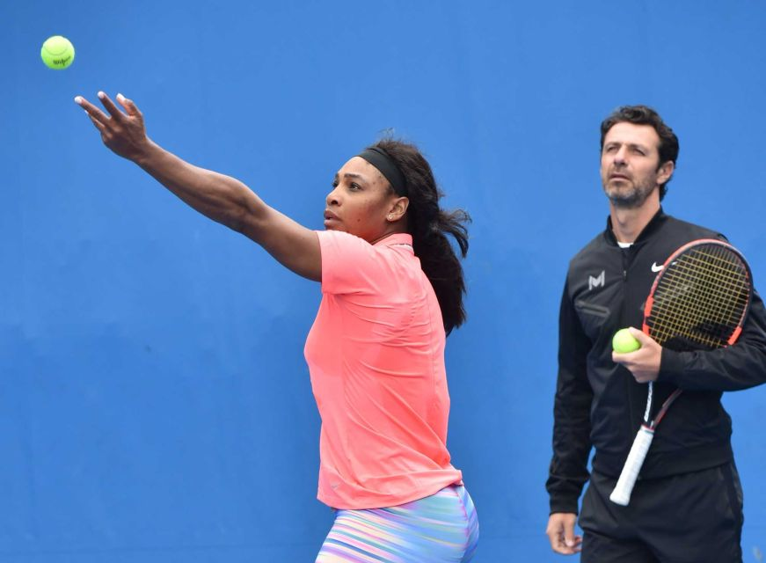
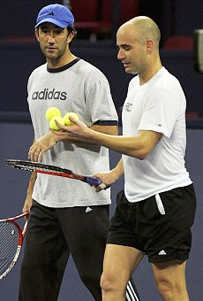

Notes:
If you want great results, You need and deserve to have a coach, someone in your corner with your best performance in mind. Professional athletes never stop being coached. Even the best in the world rely on coaches to analyze performance and suggest corrections to make the best even better.
To be successful in an interview, you will need to be relentless in pursuit of your best performance. Practice in front of friends, family, your mirror. Prepare to succeed.

Slide 5

Research
Notes:
Has anyone in this room sat for a professional certification exam? CPA? SPHR? Other? How did you prepare? What was the result? Did you have to retest?

Slide 6
Company website
company size, revenue, markets served
annual report
backgrounds of key people (check LI profile)
recent changes
M & A
strategic initiatives
press releases
Notes:
Validate and deepen the search by checking everyone on the company website with LinkedIn and Google.
The more you know about the company, the better and more targeted your questions will be. You can also make reference in your answers to facts you learned during your research. For example: I read that your primary competitor is focused on gaining advantage in XXX part of the market. When I was with ZZZ company, I put together a watch group to scan RFPs by our competitors to ensure we knew what our competition was up to. The result was we got ahead of them on some key opportunities resulting in contracts worth $$$mil.

Slide 7
LinkedIn advanced search
people who work at this company
average tenure
progressive growth
jobs available at this company
primary companies from which this org hires
primary schools from which this org recruits
2nd and 3rd level connections who may be helpful

Slide 8
Google search
recent media coverage
Business news sites and magazines
primary competitors
industry pain points
Glass Door
employee reviews
comp and benefits comments
Notes:
Ake it all in, and remember to take employee reviews with a grain of salt. There may be an ax to grind!

Slide 9

Attitude, physical appearance and environment management
Notes:
The interview begins immediately

Slide 10
The interview starts when you get the call
write everything down
send an email to confirm details
visit the site to time the drive
They interview you, YOU interview THEM!
be sure this is a good fit
Notes:
The interview begins immediately
scope out the parking
see how people dress
observe interactions
Check the weather the day before and if necessary adjust travel time, attire, UMBRELLA!

Slide 11
Ask the person scheduling the interview about dress code, for example:
How will the interview participants likely be dressed?
How do people usually dress for meetings?
How will the hiring manager be dressed?
Dress at least as well as the best dressed person in the room
Notes:
This is not the time to show your casual side. Shoes, cars, fingernails!!

Slide 12
Treat every interaction with company representatives as part of the interview
phone, security, reception, parking attendant
Be warm, respectful, and relentlessly positive
Absolutely no complaining
Notes:
HOVENSA story
The interview begins immediately
scope out the parking
see how people dress
observe interactions
Check the weather the day before and if necessary adjust travel time, attire, UMBRELLA!

Slide 13
Enter the interview confident that you have a right to be there
Greet everyone with your name and a firm handshake
Sit up straight, don’t fidget
Use deep breathing to control your nerves
Make comfortable eye contact
With a panel, scan the group as you speak
Notes:
Your comfortable and confident tone and body language will not only put you at ease, it will put the interviews at ease.
It’s hard to relate to someone who is nervous and stressed. It is your responsibility to control your nerves BEFORE YOU GET TO THE INTERVIEW. How? Practice!!!

Slide 14

Answering Questions

Slide 15
Technical Questions
confirm knowledge, skills, abilities
connect competencies to your own work experience
what you know
systems, programs, languages, applications
laws, regulations, requirements

Slide 16
Personal Questions
Tell me about yourself
Why did you leave your last job?
What is your worst trait?
How many ways can you use a pencil?

Slide 17
Behavior-based questions
provide an opportunity for you to show how you dealt with actual situations in the workplace
use S.O.A.R. stories to provide specific details that engage the interviewer and create a memorable image

Slide 18
When an interviewer fails to ask what you need to answer:
answer it anyway:
You know, that reminds me of a situation when my ability diffuse a potentially volatile situation came in handy…may I tell you about that?

Slide 19

Questions to ask Interviewers

Slide 20
The questions you ask say as much about you as the questions you answer
Make the questions relevant to the organization and the position
Refer to information you learned through your research
Notes:
Handout

Slide 21
Get into groups of 3 people
Interviewer, interviewee and observer
Use questions provided

Slide 22

Practice, Practice, Practice
Notes:
All professionals have coaches. They practice everyday. You will not be successful if you hear yourself say: I’m just going to wing it. I’m more comfortable being spontaneous.

Slide 23
Post Interview Review
What did you learn about the position/company?
Did you learn anything that confirmed or changed your interest in the position/company?
Challenges and needs of the company/role
Next steps: thank you note, follow up email
Your evaluation of the interview

Slide 24
Final Thoughts
Preparation, Preparation, Preparation
Learning as much as you can about the organization will help you to craft your stories to the environment
Be early, breathe deeply, speak slowly
You are the expert on YOU!

Slide 25

Resources
Complete interview guide

