Slide 1
JOB SEARCH PLAN WORKSHOP
A Career Prospectors & Job Assistance Ministry Workshop
Barbara Hulcher, SPHR
bhulch@yahoo.com
(804) 512-6333
Notes:
Introduce yourself and welcome participants to the Resume Basics Workshop.

Slide 2



WHY ARE WE HERE?
I have a job search plan.
I have a job search plan but am not sure how to use it.
I don’t have a job search plan.
What’s a job search plan?
This Photo by Unknown Author is licensed under CC BY-SA
Notes:
Ask participants to introduce themselves and ask why they are here.

Slide 3

AGENDA
Discuss networking perspectives
Review the job search plan
Create/update your job search plan
Walk through how to use the job search plan
Outcome: Participants will start creating/updating their job search plans, and walk away with the knowledge needed to continuously update and use their plans.
Notes:
Today we are going to:

Slide 4
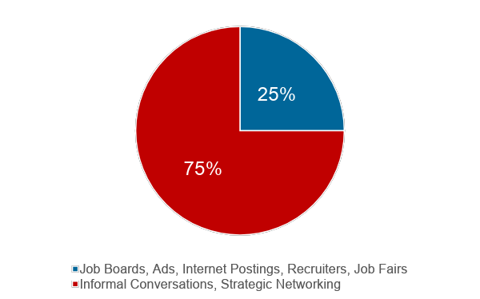
How do jobseekers get interviews?
Notes:
I’d like to start off with a question for you:
What percentage of people get jobs through job boards, advertisements, recruiters and job fairs?
Reveal slide.
So it’s really important that you have the skills and tools to network effectively.

Slide 5

NETWORKING
Networks should never be about:
Asking for a job
You doing all the talking
All take, no give
Effective networking IS about:
Assuming the person has no job for you
Don’t put someone on the spot
Asking questions
Value opinions, expertise & feedback
Asking for referrals and introductions
Appreciate generosity
Give & take - offering assistance
Being considerate of time
Notes:
Since it’s so important, let’s talk briefly about effective networking – what it isn’t and what it is.
Review slide.

Slide 6

NETWORKERS’ PERSPECTIVES
The job search is not all about you.
It’s about the HR Recruiter and Hiring Manager!
What problems can you solve?
What problems do you like to solve?
Who needs those problems solved?
Notes:
When you are meeting with others in your job search, there are at least two people (you and the hiring manager) so in turn there are at least two perspectives. It’s important to recognize that the job search and your meetings are not all about you. It’s about the hiring managers and recruiters who are looking to solve a problem. Keeping that in mind:
What problems can you solve?
What problems do you like to solve?
And who needs those problems solved?
A job search plan will help you focus on what you can do for a company – what problems you can solve – in the future.

Slide 7

JOB SEARCH COMMUNICATION
Past
Resume
Where you’ve been / what you’ve done
Present
Cover Letter
Current interest
Why you’re qualified
Future
Job Search Plan
Where you’re going
Specifics or possibilities
Tailor these to specific positions
Networking
Notes:
Most people think that all you need to create in a job search is a resume. Yes, that’s essential but a resume looks at your past. (Recommend workshop on resume writing or having Ed Landry’s team provide feedback on your resume.)
Another key tool is the cover letter which tells the recruiter and hiring manager why you’re interested in a job. Both the cover letter and resume should be customized for each position you apply to.
Last but not least, if you want have an edge when networking, the job search plan is for you. It’s a tool that will help others and yourself understand what you want to do in your future. Use your job search plan to (1) communicate what you’re looking for in a job, and (2) organize and track your job search. In other words, it is a little about you, the types of companies you’re looking for, the companies you want to learn about, and a means to find contacts.

Slide 8
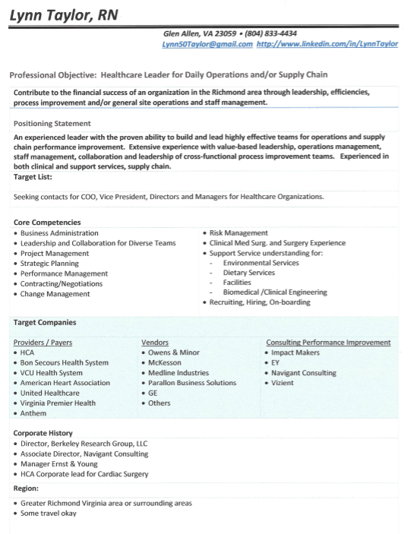

Building Your Job Search Plan
Notes:
Here’s one example of a job search plan. Now let’s break it down.

Slide 9
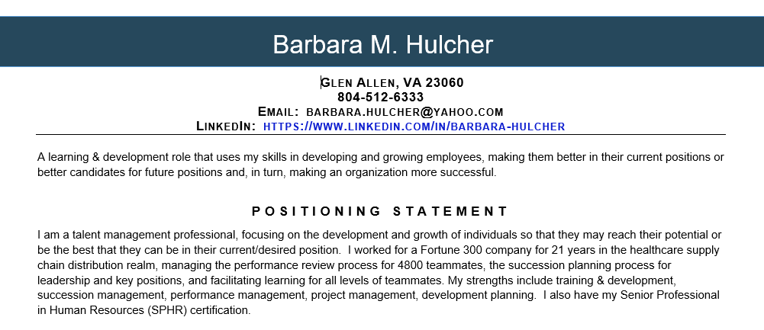
Notes:
At the top, include your contact information – include your name, city/state, phone number, email, and LinkedIn Profile URL.
Next a simple and straightforward Professional Objective. If you are clear and focused on your professional objective, it will go a long way helping others see where and how you fit into the equation. It may include previous job titles. (It is a personal preference to include or not include the words “Professional Objective.”)
Next include your Positioning Statement – a brief summary of your resume. Include relevant competencies and skills. It convinces a hiring manager you’re capable and qualified. Optional: Include achievement statements.

Slide 10
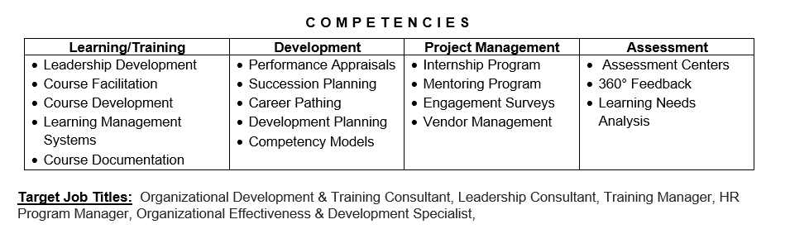
Notes:
Enter your core competencies (competency groups) and skills/characteristics.
Some folks will put Target Job Titles above the Competencies, under the Positioning Statement. Not sure what to put here, consider past titles or research job descriptions on LinkedIn and job search boards. Including job titles will help those you’re meeting with get an idea of what you’re looking for.

Slide 11
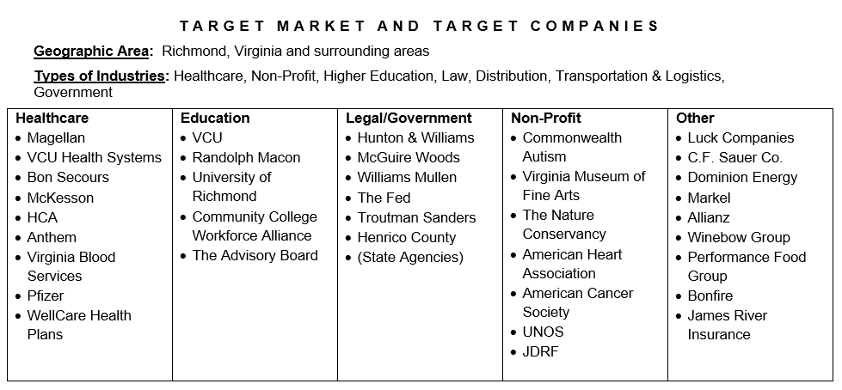
Notes:
Enter your geographic preferences. Include a note if you are willing to travel or relocate.
Enter types of industry. Technically you could skip this if you include the types of industries when you enter your Target Companies.
Enter several Target Companies under each heading. These can and should change regularly as you learn more about the companies, take companies off of your list, and identify new companies to add to your list.
Some other sections to consider:
Size of desired company
Culture
Note: You will want to keep your job search plan to one page.

Slide 12
LET’S DO IT!
1
2
3
Take the next 40 minutes to update your job search plan.
Find a partner to share your job search plan.
Take 8 minutes to provide feedback on your partner’s plan.
Notes:
Now I’d like you all to start working or refining your marketing plan. We’re going to take approximately an hour to do so, and then come back to discuss how to use your job search plan.
Pick one or two areas to work on today. For example, work on your summary or accomplishments under one work history entry – for the next 40 minutes.
Share your marked up paper copy or show your computer to your partner.
Partners should provide feedback on the updated portions. For example, does the resume include accomplishment statements? Are there any formatting errors? Etc.
Handout sample template.

Slide 13
NETWORKING MEETINGS
General Information Meetings
Informational Interviews
Notes:
So now you have the beginnings of or an updated version of a Job Search Plan. But how do you use it? You can use it at two different types of meetings:
General networking meetings to find contacts, and information about companies, occupations, and industries you are interested in. Meet with CP and JAM members, family, friends.
Informational interviews with people that have direct information on companies, opportunities, connections that interest you, such as people from your professional interest groups.
One suggestion if you’re not comfortable with networking just yet is to start with someone you know.

Slide 14
MEETING PROTOCOL
Beforehand, determine what you want to get out of the meeting.
Do you want to work there?
Do you want to work in that specific job or occupation?
Are you qualified? If not, how do you become qualified?
Expose your name and face to others
Ask “What is it like working for XZY?”
Know what’s in your job search plan.
Take 2 copies of your Job Search Plan to your meeting.
Starting the meeting:
Arrive early
Thank the person for meeting you
Confirm finishing time
Be conscientious of time constraints
Notes:
So you schedule the meeting. What’s next:
Beforehand… (Review the first part of the slide.)
Know what’s in your job search plan and why.
Take 2 copies to every meeting – one for you to write on, and one for your contact to write on. Keep notes on who your contact is going to contact. Follow up with thank you notes.
At the meeting… (Review bullets)

Slide 15
SMART: General & Informational Meetings
Summarize
Marketing Plan
Ask Questions
-
-
Notes:
During your networking meetings, remember another SMART acronym:
(The other SMART is for SOAR Stories – specific, measurable, attainable, relevant, time oriented)
Summarize what you are looking for – your professional objective, positioning statement, and target market. Be able to discuss your career goals conversationally.
Marketing (job search) Plan – share your plan. Explain what it is if the person is not familiar with it.
Ask questions and carefully consider their responses

Slide 16
ASK QUESTIONS: CONVERSATION STARTERS FOR INFORMATIONAL INTERVIEWS
What do you wish you knew when you started?
Why did you choose this occupation, industry, company?
How did you get the necessary experience?
Can you provide interview advice?
What are your like and dislikes of the occupation, industry, company?
Notes:
Here are some questions you may ask during an informational interviews.

Slide 17
THE “SMART” NETWORKING MEETING
Summarize
Marketing Plan
Ask Questions
Referrals
Are there other companies I need to research?
Trade Information
Notes:
Ask for referrals and introductions (reference your target companies). Also ask if he knows of other companies you should target.
Trade information – Networking is a two-way street. Make sure you ask “What can I help you with?” “What are you looking for?”
Afterwards, incorporate your notes for the day’s meeting(s) into your job search plan.
IMPORTANT: Don’t forget to thank him/her for her time and feedback. I also recommend sending a follow-up thank you note and perhaps reminding her what she was going to do for you and you for her.

Slide 18


THE NETWORKING BOTTOM LINE:
Networking contacts can only be helpful if they understand what it is you’re looking for. Your message must be clear to them!
Notes:
All that being said, the bottom line is…
Do you all have any questions?

Slide 19

NEXT STEPS
Update your job search plan.
Share your plan in at least (#) meetings within the next week.
Get feedback; continue to improve and update your plan.
Notes:
Let’s wrap up. When you leave here today, you have 3 tasks: (Review next steps, asking them to state how many they will share in next week.)
Thank you all for being active participants and good luck with your job search. Remember, resumes get your foot in the door; connections get you jobs.
Photo credits: Creative Commons.
Quote: Anonymous (from Picture Quotes)
Some content courtesy of Winter HR Consulting, LLC, Paul Tiernan, and Rick Albee (Hiller Avenue Partners)

Slide 20
SELL: Inside Target Companies
Summarize
Give your professional objective, positioning statement, exit statement (if necessary), target positions, target companies.
Explore
Collect information on their needs.
Link
Tie your self to their needs with your competencies, experience, and accomplishments.
Leverage
Use gathered information to get future meetings. Build on common interests. Make yourself stand out.
Notes:
Optional Slide to insert after slide 19.
Summarize – keep it conversational.
Follow up with thank you notes.

