Slide 1
PowerPoint
Introduction to the basics
Career Prospectors – session of May 27,2020

Slide 2
Goals
Beginner
Intermediate
Advanced
① To create a basic presentation with different formatting :
titles, body, background, layout.
② To insert different elements in the presentation:
links, pictures, photos, different shapes and use the Smart Art function to enhance the body text.
③To create and customize the animation of the presentation.

Slide 3
Formatting

Slide 4
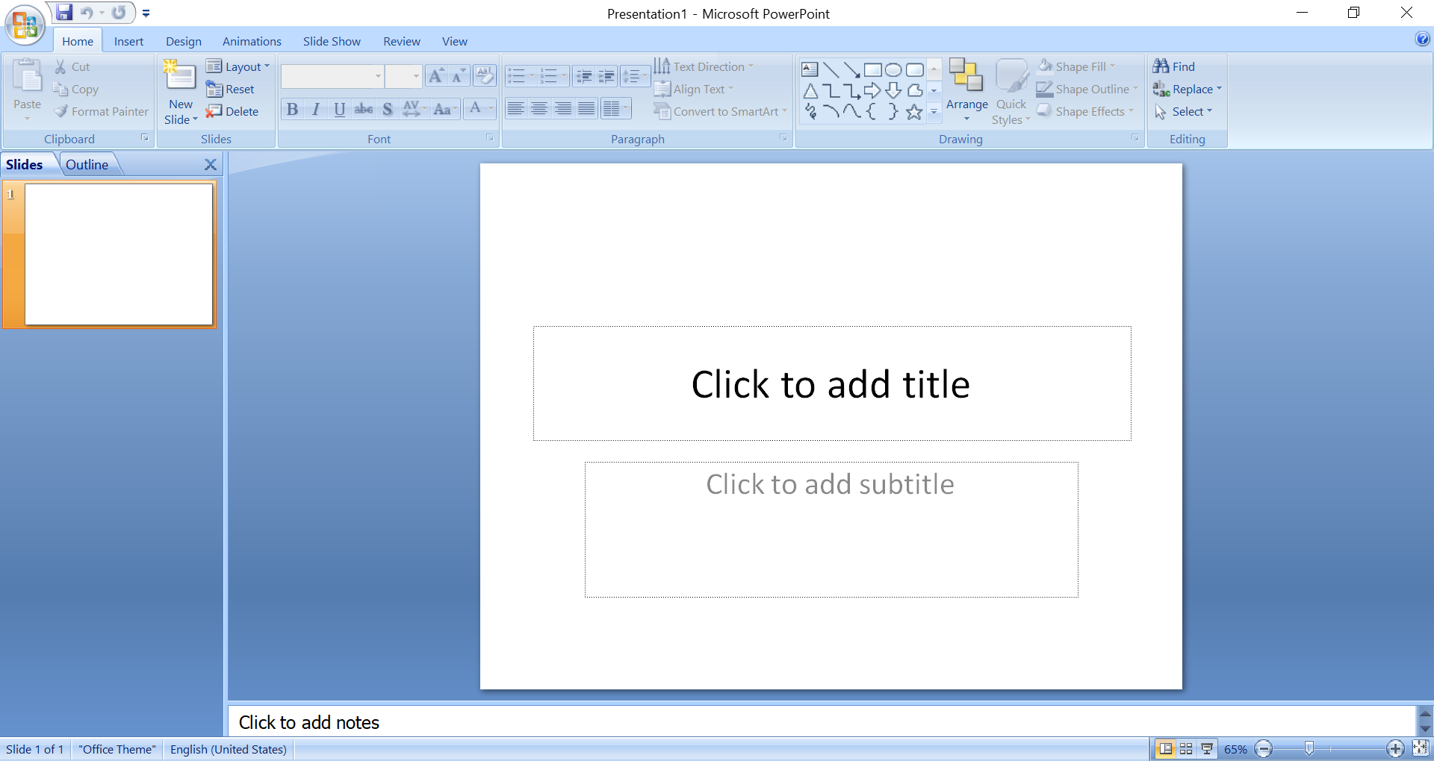
The screen you see when you create a presentation
Notes:
Following the layout

Slide 5
General overlook
Different tabs
Tab Panel
Slides window & general slides overview
the SLIDE
Notes:
The screen you see when you create a presentation

Slide 6

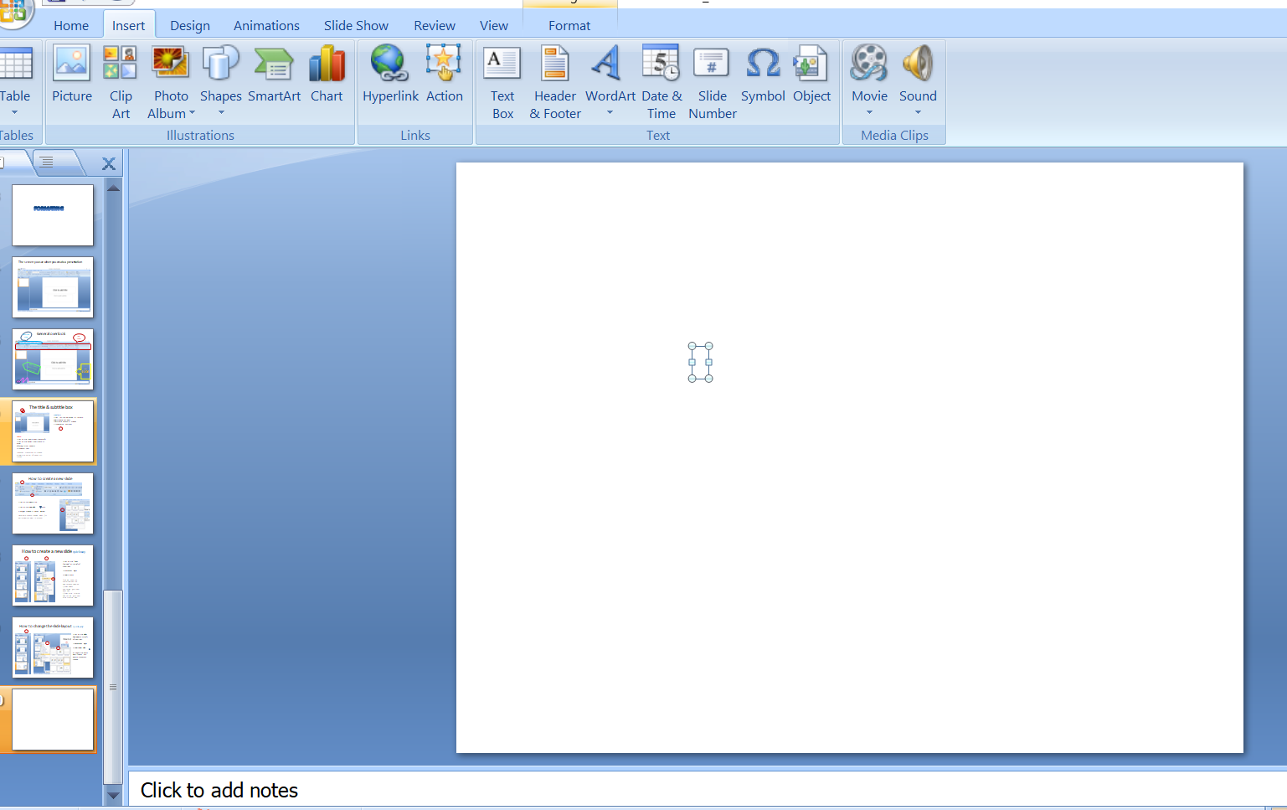
How to change title & subtitle?
To MODIFY
1- Click on the box
2- Type directly your text
1
2
To ADD
1- Click on the Insert tab on the top left
2- Click on the option Insert Text in th panel
A flashing cursor appears
3- Type your text
To position the text box on the slide
4- select the border of the box and move it
3

Slide 7
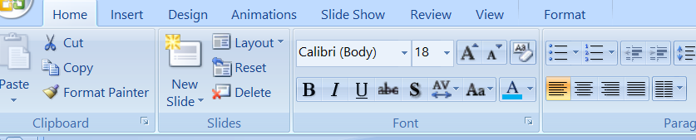
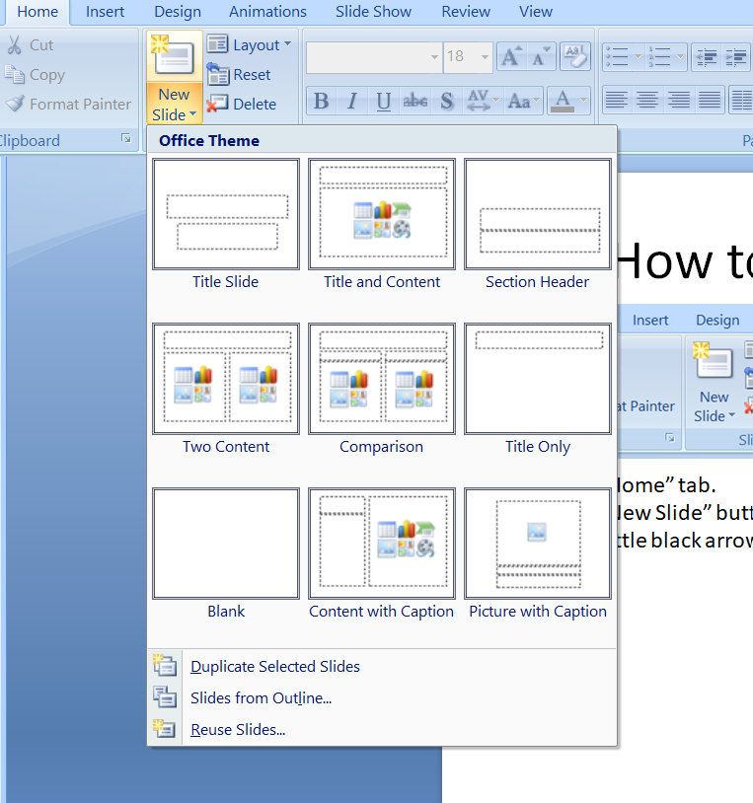
How to create a new slide?
1
2
1- Click on the Home tab.
2- Click on the New Slide button.
3- You get the slide’s choices window
Since there, choose the slide which fits better what you want to present
3
Notes:
little black arrow

Slide 8
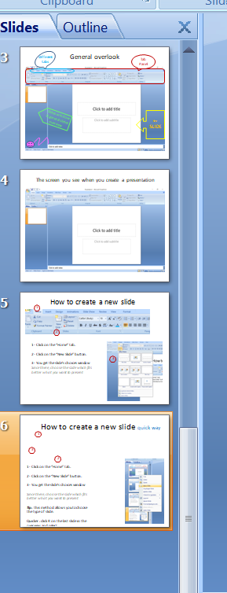
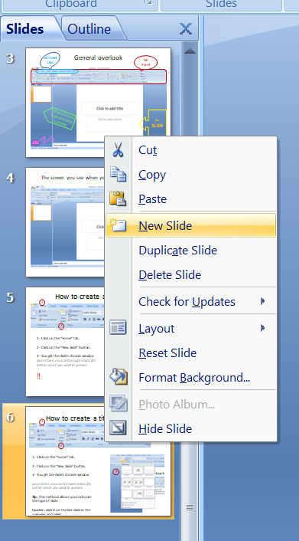
How to create a new slide? quick way
1
2
1- Click on the “Slides Overview” on the left of the screen.
2- Mouse Click Right.
3- Select Layout
‼ This will keep the same type than the slide you have selected
If it was a blank one, you will get a new blank slide
If it was a title + subtitle slide, you will get a new a title + subtitle slide
3

Slide 9
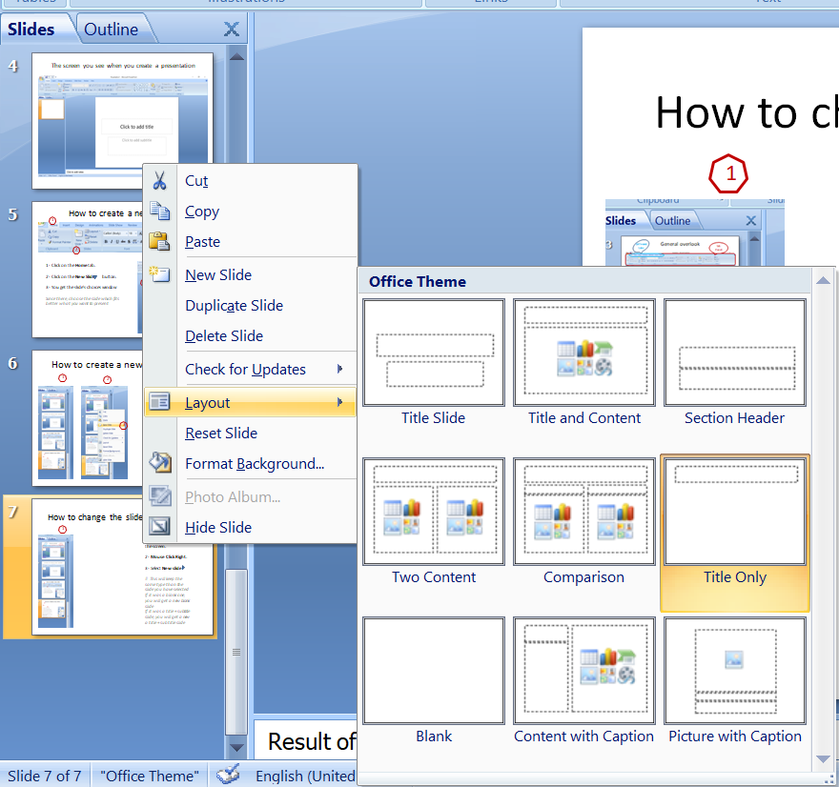
How to change the slide layout?quick way
1
1- Click on the Slides Overview on the left of the screen.
2- Mouse Click Right.
3- Select Layout
4- Choose the layout which fit what you want to present on this slide
2
3
Notes:
Result of quick way

Slide 10
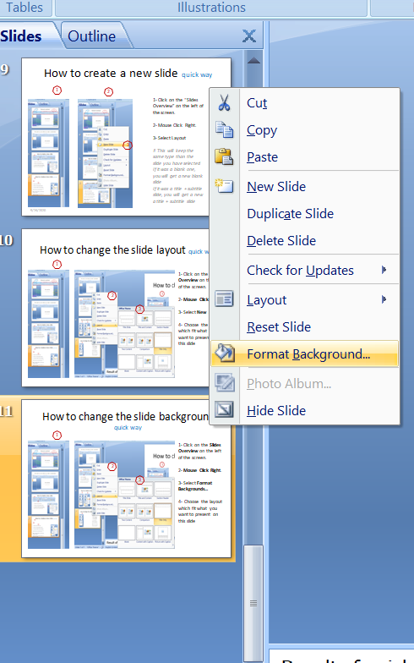
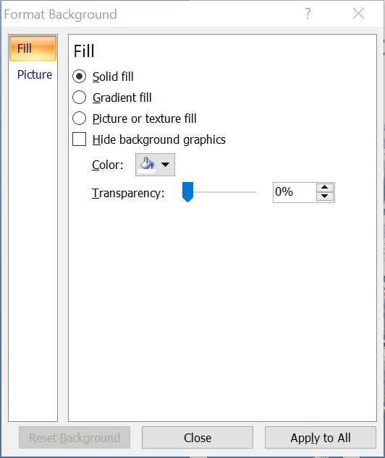
How to change the slide background ? quick way
1
2
1- Click on the Slides Overview on the left of the screen.
2- Mouse Click Right.
3- Select Format Backgrounds…
4- Modify
the color with “solid fill”
the color shading with “gradient fill”
Add a picture or texture with “picture or texture fill”
3
4
Notes:
Result of quick way

Slide 11
Insertion of elements
Picture
Clip Art
Shapes
Smart Art
Footer/date/ slide #/symbol
Hyperlinks

Slide 12
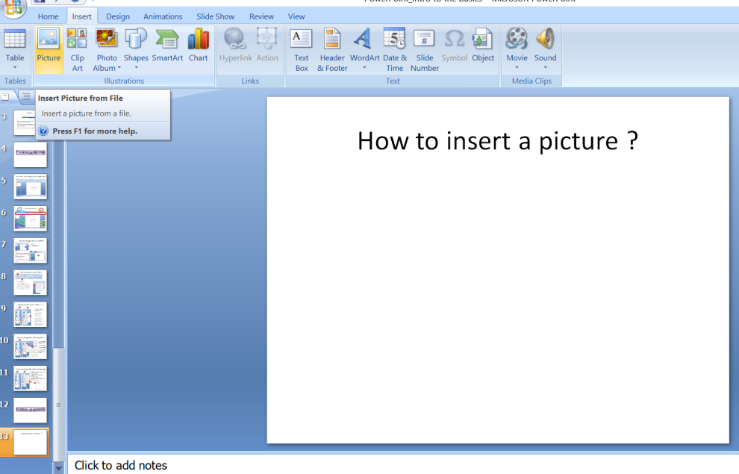
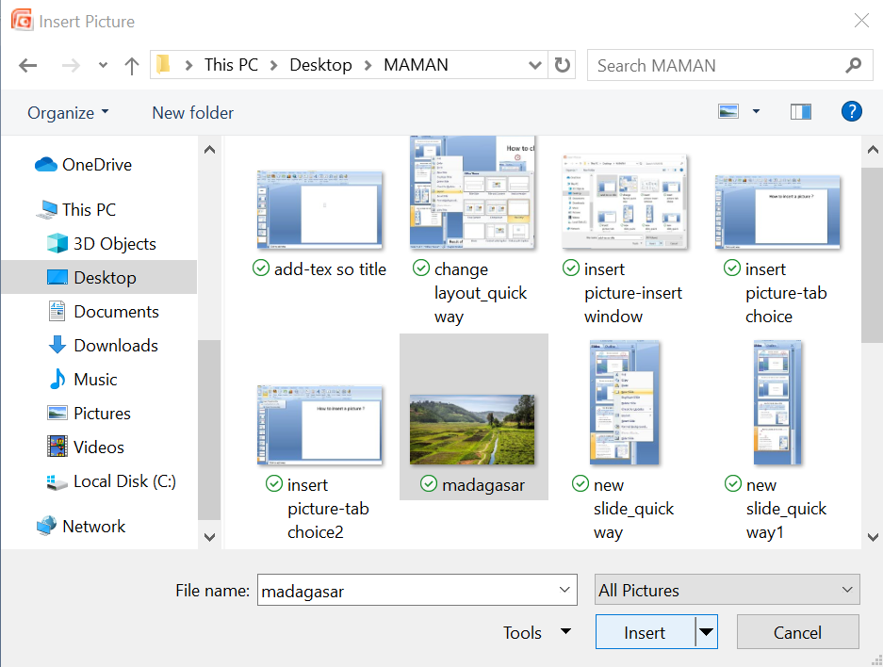
How to insert a picture ?
1- Click on the Insert tab on the left of the screen.
2- Select Picture.
3- Select the picture you want.
4- Click on the Insert button.

Slide 13

How to insert a picture ?
Result
Notes:
Holidays !!!

Slide 14


How to change the size of a picture ?
1- Click on the picture.
Some dots and squares appears around the picture:
dot = change the size by extend the corners
Square = change the size by extend the horizontal/vertical lines
2- Pass your mouse over one of the dots and select it.
3- Drag it to increase/decrease the size
4- Do the same with the square
Note: the double arrow allows you to move the picture all around the slide
upsized
downsized

Slide 15
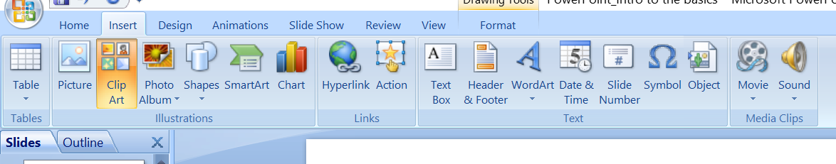
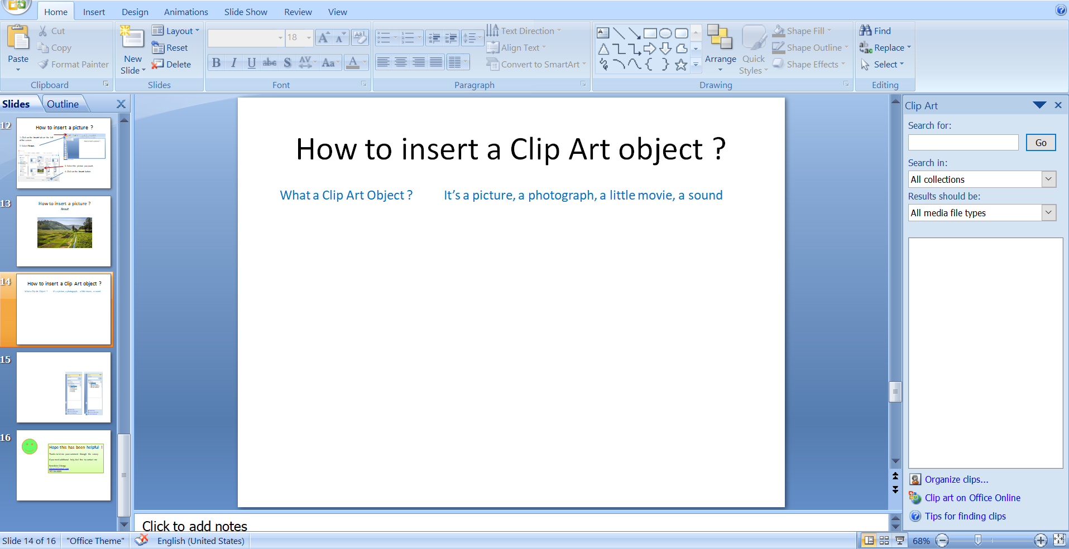
How to insert a Clip Art object ?
What a Clip Art Object ? It’s a picture, a photograph, a little movie, a sound
1- Click on the Insert tab on the left of the screen.
2- Select Clip Art.
The Clip Art gallery appears on the right side of the screen

Slide 16
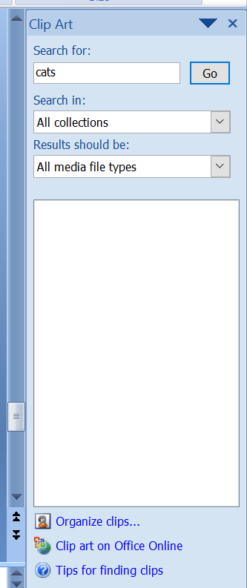
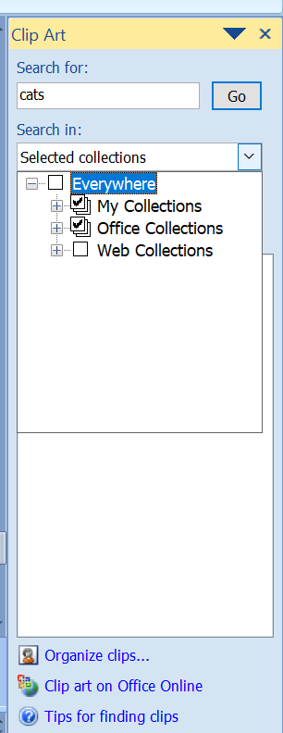
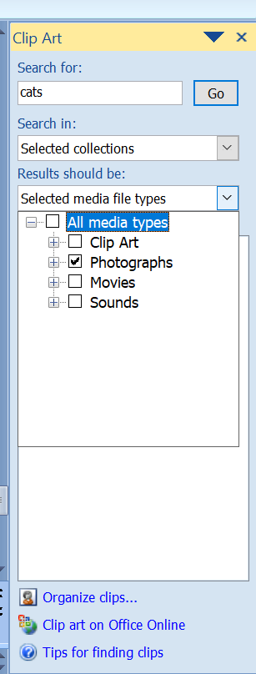
How to insert a Clip Art object ?
1- Select the subject you are looking for. (e.g. cats)
2- Select where you want to search a picture.
My collection = my computer
Office collection = Windows library
Web collections = internet
3- Select the type of file you want to find.
Clip Art = pictures gallery
Photographs
Movies
Sounds
4- Click on the “Go” button
4
1
2
3

Slide 17
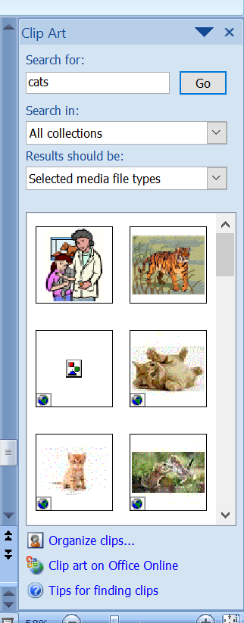


How to insert a Clip Art object ?
Result
Result of the search
To insert the picture chosen, double click on it
The picture is inserted in a big size:
-resize it by clicking on it to get the shape dots/squares around the picture
-resize to your choice

Slide 18
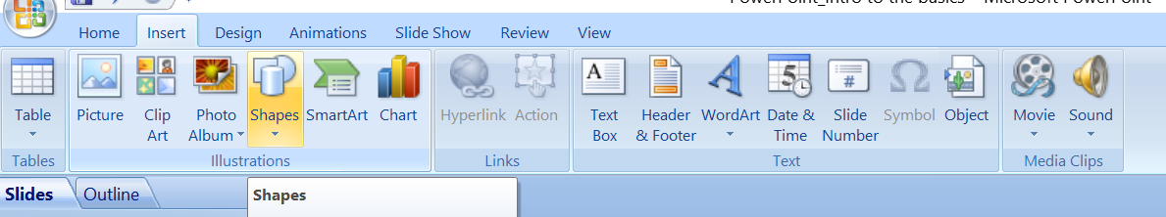
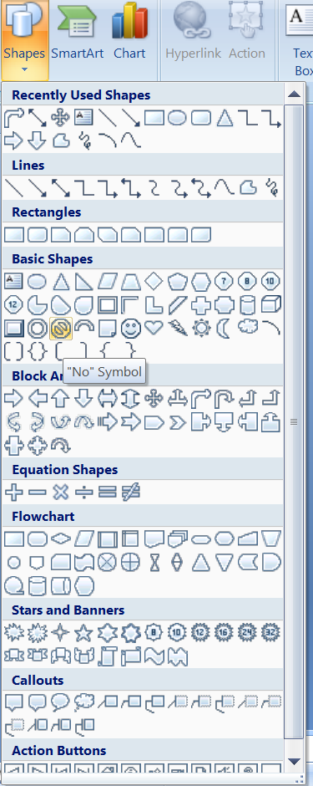
How to insert a Shape?
What a Shape ? It a very usual and common drawing (like arrow), pre-programed, ready to use
1- Click on the Insert tab on the left of the screen.
2- Select Shapes
3-You get the slide’s choices window
Since there, choose the Shape which fits better what you want to present
Eg: forbiden sign
Click once and draw it.
Resize if necessary

Slide 19
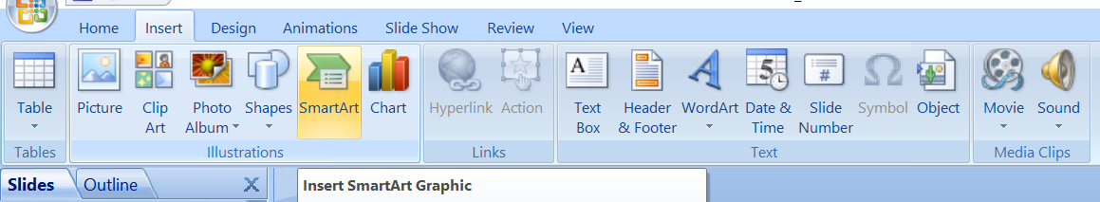
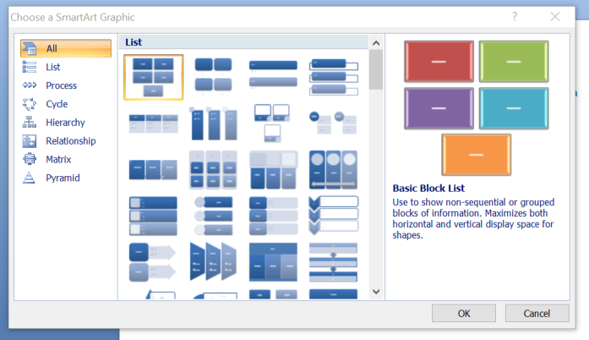
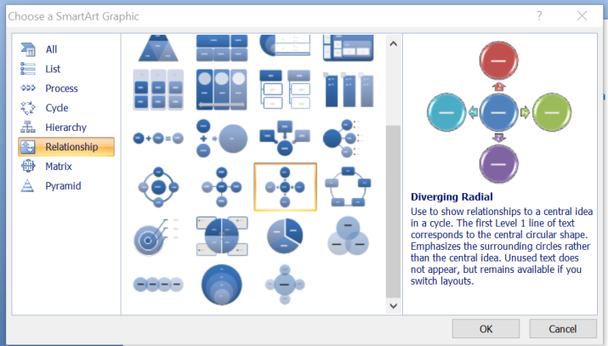
How to insert SmartArt?
What SmartArt ? Is a way to use drawings instead of long text (like a hierarchy list, a pyramid…)
1- Click on the Insert tab on the left of the screen.
2- Select SmartArt
3-You get the slide’s choices window
4-Choose
a- the theme
b- the graphic which fits better what you want to present
5-Click on the OK button
a
b

Slide 20
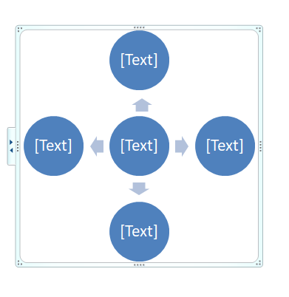
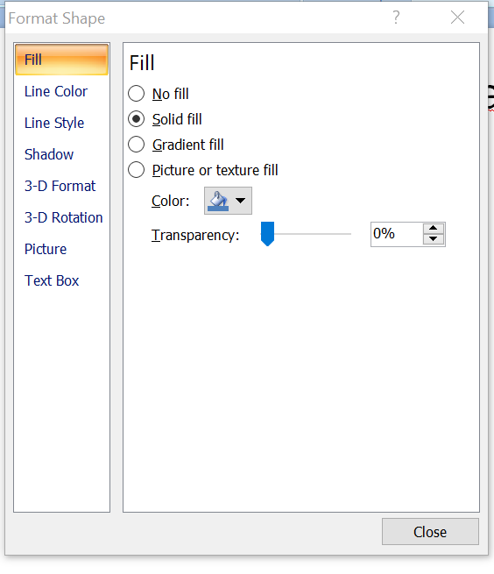
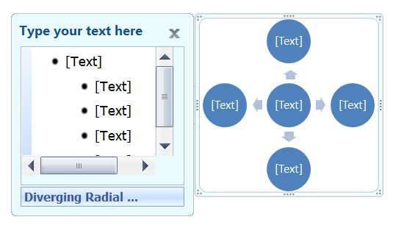
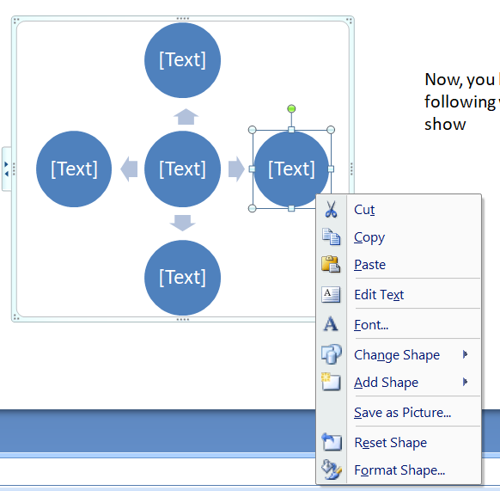
How to modify a SmartArt graphic?
1- Click on the graphic to get the border line
2- Click on the double arrow
3- Enter your text for each bullet
4- Select a bullet and click Right to obtain the option Format Shape …
5- Modify the color, the border line and even the shape of the bullet
6- Click on the Close button
Once the graphic inserted
1
2
5
3
6
4

Slide 21
SmartArt Final Result
Student
Teatchers
Admin
Health Dept
Sport Coaches

Slide 22
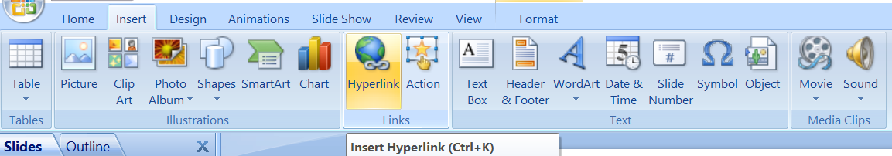
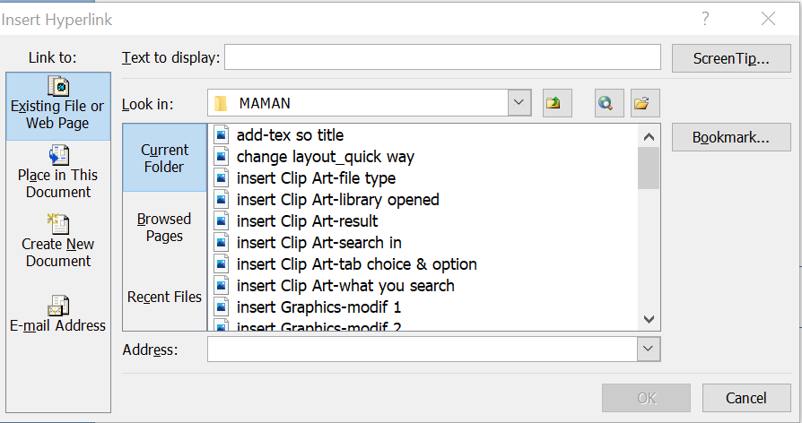
How to insert Hyperlinks ?
!!! A hyperlink can only be inserted in a Text zone (see slide 6)
1- Click on the Insert tab on the left of the screen.
2- Select Hyperlinks
3- Select Existing file or web page on the left side of the screen
4- Click on Address and type (or copy/paste) your website address
Now 2 choices:
Option A- you want to see the address
or
Option B- you want to see another text

Slide 23
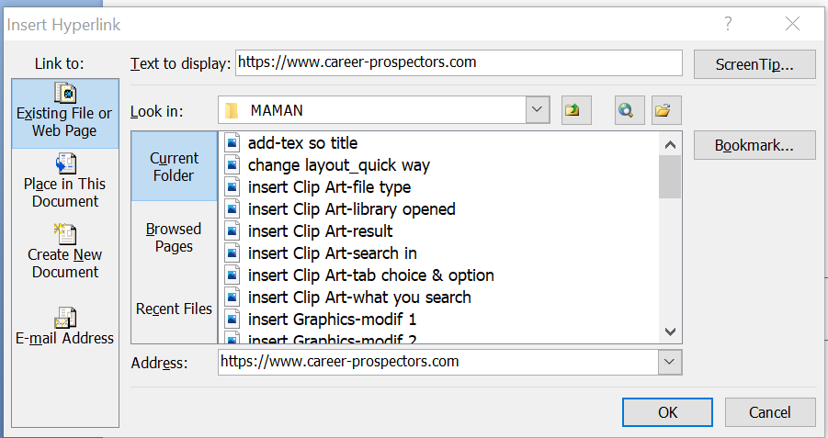
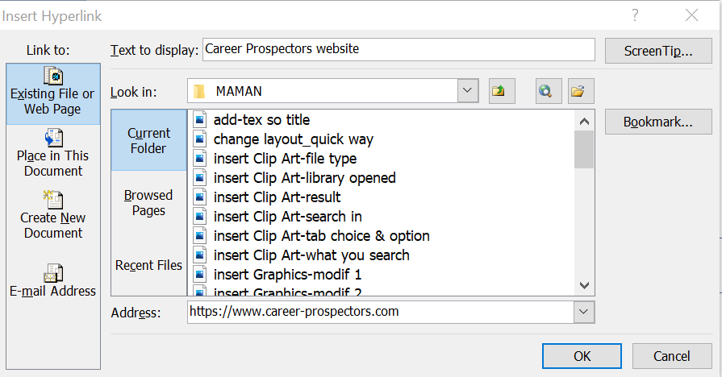
How to insert Hyperlinks ?
Choice of text appearance
Option A
To find this presentation, please go on the Career Prospectors website
https://www.career-prospectors.com
Option B
To find this presentation, please go on the
Career Prospectors website
Once you have entered your website address, the field Text to display is filled automatically with the same address
So nothing to change, click on OK
Once you have entered your website address
Go in the field Text to display
Type the text you want to see
Click on OK

Slide 24
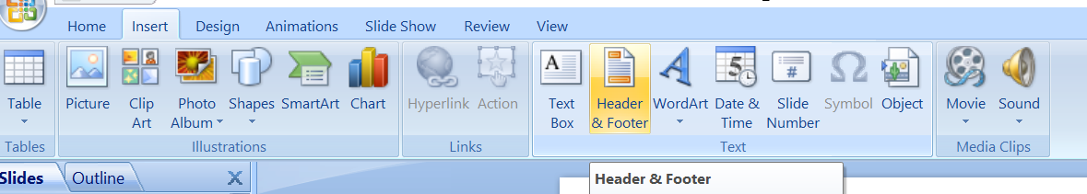
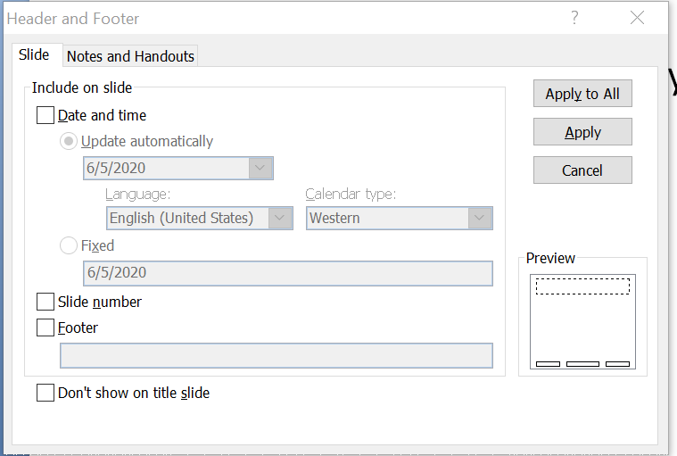
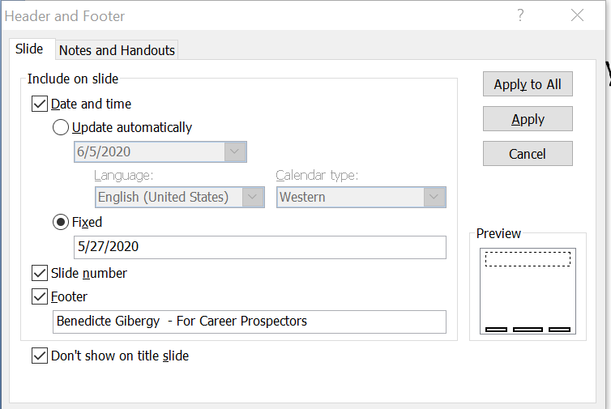
How to insert
Footer - Date - Slide# - symbol ?
1- Click on the Insert tab on the left of the screen.
2- Select Heade Header & Footer r & Footer
3- You get the Header & Footer Options screen
4- Select the options and enter the text you want to see on the slide
5- Click on:
Apply = to apply the modification ONLY on the slide you are on
Or
Apply to All = = to apply the modification on ALL slides (the whole presentation0

Slide 25
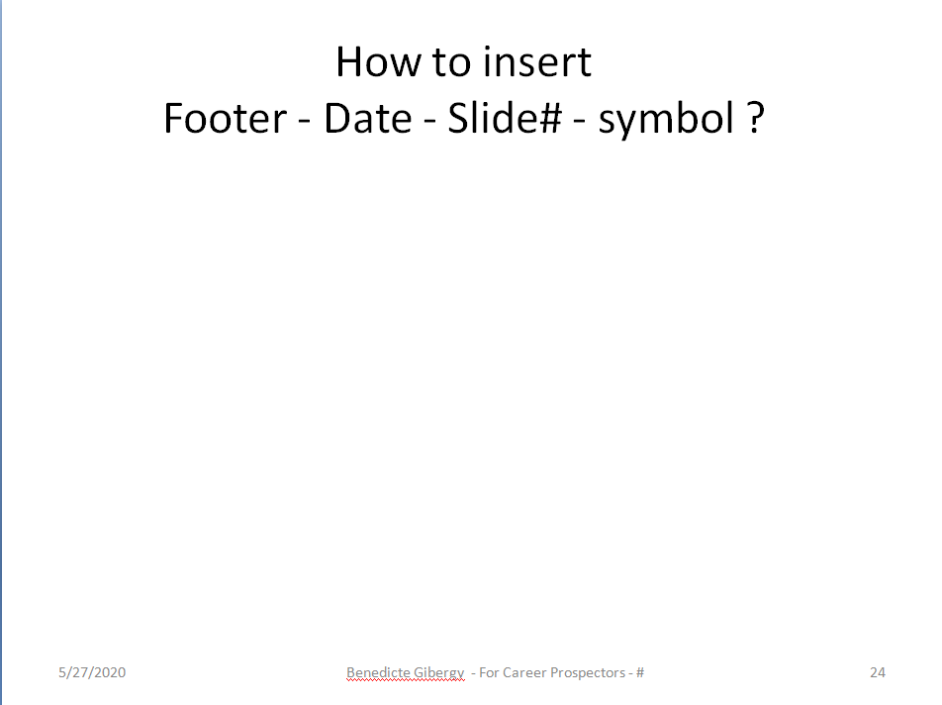
How to insert
Footer - Date - Slide# - symbol ?
Result

Slide 26
Hope this has been helpful !
If you need additional help, or make any comments/advices,
feel free to contact me
Benedicte Gibergy
gibergyb@gmail.com

