Slide 1

Resume Basics
Ed Landry
Founder & Leader
Jobs Assistance Ministry

Slide 2
Proposed Ground Rules
Willing to listen to and consider all suggestions and advice
Take ownership of your resume
Confidentiality
Participate! Willing to share and help one another
Use The Checklist To Revise and Update Your Resume

Slide 3
My Biases
Easy To Read: No Mouse Print
Well Formatted: No Spelling or Grammatical Errors
White Space Is Your Friend
Don’t Use Personal Pronouns: I, Me, Mine Etc.
Two Pages Max
Avoid Special Graphics, Pictures, Tables or Borders
Chronological NOT Functional
Clearly Defined Professional Profile -- “Brand” Yourself Clearly
No Generic Descriptors
Specific Skills and Competencies if Appropriate
Accomplishments NOT Tasks
Like Flavoring The Soup: Everyone Has An Opinion

Slide 4
What Recruiters Say….
Not customized for the job applied for
Cliché phrases, e.g., out of the box thinker
Too artistic
Grammatical or spelling errors e.g., Capitol One
Crammed text
Flowery language
Too many pages (One Page Max???)
Not celebrating promotions
Listing responsibilities, not accomplishments
Not quantifying accomplishments
Writing to one’s current or most recent job
Professional objective or seeking statement
References Available
Unprofessional email addresses
Not “synching” resume with on-line profiles, e.g., Linkedin

Slide 5
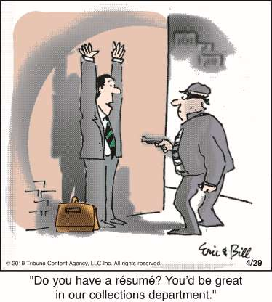

Slide 6
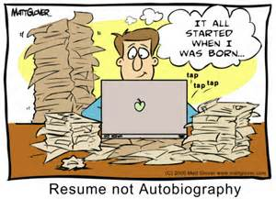
Your Resume: What It Is and Is Not
Your Resume Is Not:
Entire job history
A job description
Your Resume Is:
A marketing brochure
What distinguishes you from other qualified candidates
Your specialized skills and competencies
Major accomplishments
A tool to obtain an interview
Your value to a prospective employer

Slide 7
Before the resume
Self-assessment
Have a clear goal

Slide 8
Self-assessment/Inventory
Skills, knowledge
Interests
Deal-breakers

Slide 9
Basics . . .
Chronological or
Functional?

Slide 10
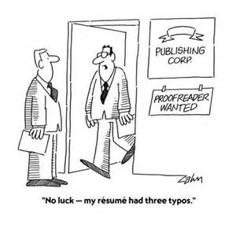
Appearance Counts
White space is your friend
No mouse print: 10.5 pitch minimum
Contemporary fonts: Calibri, Arial
Wide margins, ideally one inch
Space between accomplishments
Two pages maximum
Consistent formatting
No spelling mistakes, typos or
grammatical errors
Do not rely on spell check only
First Impression Is The Lasting One

Slide 11
Customize? Multiple Versions?
Should I customize my resume for each job application?
How many versions of my resume should I have?
What if I want to have multiple career objectives with a resume for each?
Should I have both a functional and chronological resume?

Slide 12
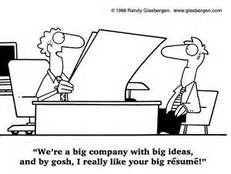

Slide 13
Your Identity, “Brand:” Generic VS Focused
_______ Professional
Business analyst
HR manager
Project leader
Business consultant
Sales and marketing manager
IT leader
Attorney
Trainer
Life insurance actuary
Cost accountant
Tax attorney
Treasury analyst
IT security consultant
Consumer market researcher
Bank compliance auditor
Commercial loan underwriter
Compensation analyst
Employee relations ombudsperson
Research the job market and find the right balance

Slide 14
Key Words
Generic
Results-oriented
Team Player
Analytical
Time Management
Business Requirements
Special Projects
Detail Oriented
Adaptable
Specific
Certified Black Belt
Scrum Master
Lean Process Analysis
Fluent in German & French
Cost Estimating
Demographic/Primary Research
Monte Carlo Simulation
When applying for a job, your resume should include key words from the job posting. Exact wording, multiple times

Slide 16
Template

Slide 19
Template
Do Not Add: References Upon Request

Slide 20
Professional Profile
Focus On:
Qualities that distinguish you: What makes you “special”
Competencies and skills
Values, e.g., Integrity
Avoid
Generic Descriptors e.g., Finance Professional
Fluff Words and Expressions e.g., Results-oriented, Team Player
Self-Assessment Is Critical, First Step

Slide 21
Professional Summary -- Examples
An enthusiastic and highly successful business professional with a proven track record of consistently achieving and exceeding goals. Core strengths include strategically assessing business problems, building coalitions, communicating difficult concepts, and creating solutions.
Seasoned project manager with extensive experience in business process reengineering, continuous quality improvement and creative use of information systems technology to address business opportunities. Proven expertise in analyzing and restructuring corporate functions. Excellent presentation, training and writing skills. Innovative decision-maker with focus on practical yet creative solutions. Skilled at negotiating, facilitating and developing consensus for new initiatives.

Slide 22
Professional Summary -- Examples
Sales management leader with a successful track record of developing and implementing strategies and programs that result in increased distribution and sales volume. Demonstrated negotiation and value based sales skills. Motivated team player with a passion and dedication to serve customers and build business relationships
Innovative marketing administrator and national events expert with proven creative and management ability in hospitality and entertainment. Able to conceptualize and launch marketing campaigns and successfully facilitate smooth running of major national events, delivering results on time and to impeccable standards. Aggressive, confident, well-spoken negotiator and solutions - evolver.

Slide 23
Accomplishments, Not Responsibilities
Responsibilities
Performed
Responsible for
Managed
Oversaw
Provided
Coordinated
Conducted
Prepared
Maintained
Accomplishments
Created
Initiated
Designed
Developed
Decreased
Increased
Reorganized
Strengthened
Overhauled
Not what you did but how well. What did you achieve?

Slide 24
What I Hear….
I don’t have any accomplishments. I just did a great job day in and day out.
We were never asked to quantify our work. So how can I do it now?
Identifying accomplishments is very, very difficult.
I can’t quantify with any precision.
If I can’t quantify, do I need to show results?

Slide 25
Accomplishment
Good
Managed a portfolio of agricultural products that generated gross sales of over $21 million annually.
Better
Increased gross sales of agricultural products by $2 million, a 20% overall increase
Best
Created new prospecting techniques that uncovered untapped markets for agricultural products resulting in increased sales of $2 million, a 20% year over year increase. Recognized as sales leader for 2014

Slide 26
Accomplishment
Good
Drafted grant proposal
Better
Drafted grant proposal obtaining $300 K in new funding
Best
Identified grant opportunity, persuaded foundation leader to apply, drafted proposal, and obtained $300 K in new funding which was used to implement a food program in western Africa

Slide 27
Accomplishment
Good
Directed a staff of 20 customer service staff in a fast-paced call center
Better
Improved customer service by reducing average speed of answer from 20 seconds to 10 seconds
Best
Engaged team in identifying root causes of slow average speed of answer (ASA), designed new process, improving phone call queuing and reducing ASA from 30 to 10 seconds. Improved process increased customer satisfaction and retention by an estimated 20%

Slide 28
Is Your Resume?
Error Free
Two Pages Max
Easy To Read
Well Formatted
Focused Profile -- NOT Generic
Accomplishments Not Tasks
Including Results Ideally Quantified

Slide 29
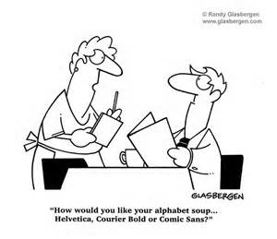
Final Thoughts:
Everyone has an opinion
Sometimes conflicting
Take ownership and control
“Brand” yourself clearly
Update for specific jobs
Key words exactly as in job posting
Get feedback and continue to improve and update
Do NOT Pay Someone To Write Your Resume.

Slide 30

Questions? Comments?

