Slide 1
Understanding Yourself and Others
By John Flynn
July, 2018

Slide 2
Beginning instructions:
If you have completed the BEST survey, please have it ready, but don’t show anyone else your answers or tell anyone what your style is.
If you have not completed it, let us know and we’ll give you one to fill out. Please fill it out and score it without anyone else seeing your results.
We will start when everyone has their profiles and is ready to go.

Slide 3
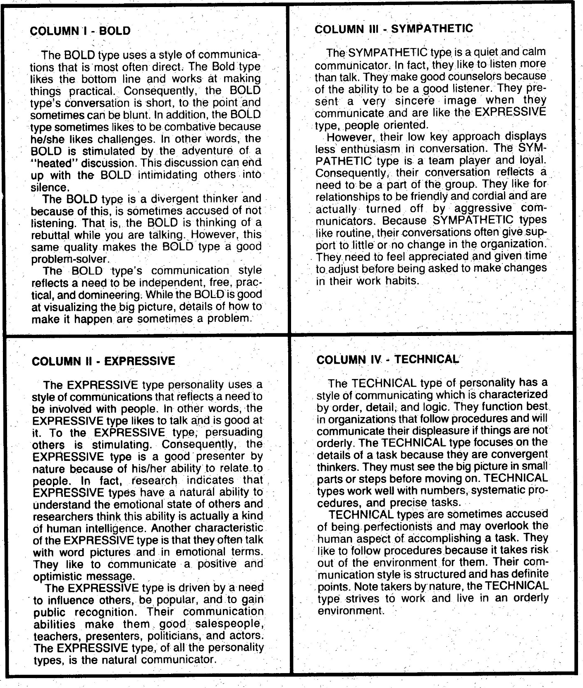
BEST

Slide 4
But before we get to that... Some questions...
Raise your hand if you tailor your resume and/or your cover letter to the job descriptions of the jobs you’re applying for...
Keep your hand up if you tailor your answers to interview questions based on interviewers’ facial expressions and body language...
Now, keep your hand up if you think those two techniques are 100% accurate and infallible guides to the decision making behavior of people hiring...
If they are not infallible, why do you do those things?
It’s the same for what I am about to tell you. These techniques are not 100% accurate. There are no infallible guides to human thought and behavior!
What follows are techniques for getting clues to how your networking targets and interviewers are looking for and how they will react to the way you talk to them. But just like your interpretation of job descriptions and body language, they are just clues.

Slide 5
Remember:
These are stereotypes!
They don’t define people.
The goal is to increase your chances of having conversations that connect.
It is not a formula for perfect communication.
This doesn’t always lead to correct assumptions about people. But most often, it does.

Slide 6
Four square assessments
There are many kinds of “four square” communications/personality assessments, including:
“BEST”
“DiSC” (There are multiple variations of DiSC)
“Personality Test”
“Communication Styles”
“The Color Code”
Many more...
It’s important to know what they’re really telling you.
We all have the BEST assessment in front of us, so we will use that as a model.
They all pretend to be different and they use different terminology, because someone is making money from each of them.

Slide 7

BOLD | Sympathetic
Expressive! | Technical
BEST

Slide 8
“BOLD” = “Driver” “Dominance” “Functional” “Action ortiented” “Activist” | “Sympathetic” = “Personal” “Amiable” “People oriented” “Supportive” “Reflector” “Steadiness”
“Expressive” = “Intuitive” “Idea oriented” “Influence” “Inspiring” ”Theorist” | “Technical” = “Analytical” “Process oriented” “Conscientiousness” “Pragmatist”
Some of the style names from competing assessments:
Their relative positions on different 4-squares may be different.
Don’t get caught up in the words!
They do not correspond to gender or job titles.

Slide 9
BOLD | Sympathetic
Expressive! | Technical
20%
50%
Rough Style Breakdowns in North America
10%
20%

Slide 10
BOLD | Sympathetic
Expressive! | Technical
Not many people are really here
Or here
The Key to Understanding Styles
Or here
Or here

Slide 11
BOLD | Sympathetic
Expressive! | Technical
But they may be here
Mastering Styles

Slide 12
BOLD | Sympathetic
Expressive! | Technical
Or here
Mastering Styles

Slide 13
BOLD | Sympathetic
Expressive! | Technical
Mastering Styles
Or here

Slide 14
BOLD | Sympathetic
Expressive! | Technical
Or here
Mastering Styles

Slide 15
BOLD | Sympathetic
Expressive! | Technical
Your goal is to be able to act as if you are here, covering all four as much as you can, depending on who you’re talking to.
Mastering Styles

Slide 16
BOLD | Sympathetic
Expressive! | Technical
People/Relationships

Slide 17
BOLD | Sympathetic
Expressive! | Technical
Tasks/Things

Slide 18
Consider the difference between these two interview questions...
“Tell me about a situation when you and a colleague had a difference of opinion about how to proceed on a project. How did you resolve it and what was the result?”
“Tell me about a situation when there was a disagreement about how to proceed on a project. How did you resolve it and what was the result?”
Notes:
The first focuses on people: you and a colleague. The second focuses on “a situation,” which is a thing.

Slide 19
BOLD | Sympathetic
Expressive! | Technical
Tell/Outgoing
Listen/Ask/Reserved

Slide 20
Consider...
Is the person really asking you what you think?
OR
Is their question telling you what they want you to agree with?

Slide 21
BOLD Tells more than listens More concerned about things and tasks than people and relationships | Sympathetic Listens more than tells More concerned about people and relationships than tasks and things
Expressive! Tells more than listens More concerned about people and relationships than tasks and things | Technical Listens more than tells More concerned about tasks and things than people and relationships

Slide 22
BOLD “Get to the point” Not the best listener Assertive Concerned about results “Let’s move on!” | Sympathetic Chit chat, small talk Good listener Non-assertive Social Interested in you personally
Expressive! Concerned about big ideas, creativity Wants to be the coolest, smartest person in the room Not the best listener | Technical Gets in the weeds Concerned about facts and correctness Good listener, but only up to a point
Style Clues: Speech

Slide 23
BOLD Functional Sparse Status symbols Plans on the wall | Sympathetic Pictures of people and events, esp. family Greeting cards Plants School stuff
Expressive! Games, widgets, memes Artwork Conversation pieces Cutting edge thinking books | Technical Rules on the wall Reference books
Style Clues: Office
This is all relative to the environment!

Slide 24
BOLD Functional Powerful Status jewelry | Sympathetic What everyone else is wearing What would or would fit in Sentimental or affiliation jewelry
Expressive! Fashionable Colorful Different Unique | Technical Company dress code or very casual What is most appropriate
Style Clues: Dress
This is all relative to the environment!

Slide 25
BOLD | Sympathetic
Expressive! | Technical
Styles Under Stress
Notes:
Styles will tend to switch corners (in this 4-square model) under stress or frustration. So if a Bold style gets frustrated, they may switch to a Technical style. The Bold says, “Let’s get to the point and move on.” The group does not cooperate. So the Bold says, “We have an agreed-on agenda that is time boxed and we are over time for this topic. We need to stay on track.”

Slide 26
“Describe a time when you improved procedures in your organization.”
BOLD | Sympathetic
Expressive! | Technical
How might you answer differently for each style?

Slide 27
Pacing
Pacing is synchronizing with the other person’s:
Rate of speech
Body language
Tone of voice
Enthusiasm
Etc.
Pacing is NOT mimicking – be discreet!

Slide 28
Dealing with a group/panel interview
Figure out who the senior/most influential person in the room is.
Take your pacing cues from that person.
Make the most eye contact with that person.
For questions that seem to be of interest to the whole group, give hybrid answers, but emphasize the main person’s style.
If an individual in the group asks you a direct question that seems to be just of concern to them personally direct you answer to their perceived style.
This is an art!

Slide 29
Hybrid answers that cover all the styles: ^{B - E - S - T}
“Describe a time when you improved procedures in your organization.”
“On a project for XYZ Corporation, we had an issue getting decisions made quickly^{B} on account setups. I solved the problem by applying sound leadership techniques^{E}. I realized we needed to incorporate best practices^{E}, follow the compliance rules^{T} and get everyone’s input^{S}. I created an innovative^{E} workflow process for doing all that. The results were that our account setup time was reduced by 30%^{B}, we were always in compliance^{T} and everyone felt they had input on every decision^{S}.”

Slide 30
Exercise
You may have participated in a version of this exercise before, but this one will have a different purpose and a different outcome than what you’ve seen before.
At your table, you will have five minutes to come to a answer to the problem that the whole table agrees to AND decide who will present the table’s answer. The whole table has to agree!
Through the discussion, try to determine what style the other people at your table are.
See if you can use use the ideas in the presentation to more effectively communicate your ideas to the other people at the table based on their style.

Slide 31
Lifeboat Exercise
You and the members of your table are on a sinking ship way out at sea.
Before the ship sinks, you have five minutes to decide on five things from a list to take on your lifeboat. That is all you will have.
The items on the list are just as described. Do not assume they come with anything else.
The lifeboat is a plain wooden boat, no sails, no motor, no equipment or amenities of any kind.
Your task is to pick five things that will your group to survive long enough to be rescued. You have no idea how long that will be.
Please take the survival aspect seriously and know there are right and wrong answers. The more seriously you take this, the more your different communication styles will become visible.

Slide 32
Any questions?
Ready, get set...

Slide 33
You can choose five of these things to help you survive in your lifeboat – You have five minutes to decide.
A sextant
A shaving mirror
A quantity of mosquito netting
A 25 liter container of water
A case of army rations
Maps of the Atlantic Ocean
A floating seat cushion
A 10 liter can of oil/petrol mixture
A small transistor radio with batteries
20 square feet of opaque plastic sheeting
A can of shark repellent
One bottle of 160 proof rum
15 feet of nylon rope
2 boxes of chocolate bars
An ocean fishing kit & pole

Slide 34
Time’s Up!
Each table reports out by item number.
No further discussion!
A sextant
A shaving mirror
A quantity of mosquito netting
A 25 liter container of water
A case of army rations
Maps of the Atlantic Ocean
A floating seat cushion
A 10 liter can of oil/petrol mixture
A small transistor radio with batteries
20 square feet of opaque plastic sheeting
A can of shark repellent
One bottle of 160 proof rum
15 feet of nylon rope
2 boxes of chocolate bars
An ocean fishing kit & pole

Slide 35
Exercise Debrief
Were you able to determine what style the other people in your group are?
Were you able to determine how strong they are in that style and if they have a backup style?
Were you able to use use the ideas in the presentation to more effectively communicate with other the other people in their group?
Do you think the mix of styles in your group affected the choices your table finally decided on? How?

Slide 36
Does anyone want to see the right answers?
The following answers are courtesy of Her Majesty’s Coast Guard (HMCG), which is the official title of the British Coast Guard.

Slide 37
Exercise Debrief
Best Answers
A shaving mirror
A 10 liter can of oil/petrol mixture*
A 25 liter container of water
A case of army rations
20 square feet of opaque plastic sheeting
Runner Ups
2 boxes of chocolate bars
An ocean fishing kit & pole
15 feet of nylon rope
One bottle of 160 proof rum
A can of shark repellant*
* Problematic answers

