Slide 2

The Two Hour Job Search
Steve Dalton is a senior career consultant and career programming director for the full-time MBA program at Duke University’s Fuqua School of Business. He holds his own MBA from the same institution and a chemical engineering degree from Case Western Reserve University. Prior to entering the career services industry, Dalton was an associate marketing manager at General Mills and a strategy consultant at A.T. Kearney.
Used at over 20 MBA schools globally: Duke, William & Mary, Berkley, UCLA, Yale, Rice and more

Slide 3
What is the Two Hour Job Search?
An Ultra specific process for using technology to find the right job fast
Strategy to tap the hidden job market
Pareto Principle: 80% of results comes from 20% of effort
Choose what you want to do
Write resume, linked in….
Prioritize target employers
Contact target employers
Recruit advocates to provide internal referrals
Interview
Select an offer
The 2 Hour
Job Search

Slide 4
What Happens in 2 Hours?
Step 1: Prioritize Companies
Step 2: Find Contacts & Employees
Step 3: Recruit Boosters & Advocates
70 min
50 min
Ongoing 3B7 Routine
“The 2-Hours refers to how long I would spend job searching if you told me I had to start looking for a job right now — after two hours, I’d be done for the day, since any less time would be insufficient and any more, unnecessary.”
Steve Dalton

Slide 5
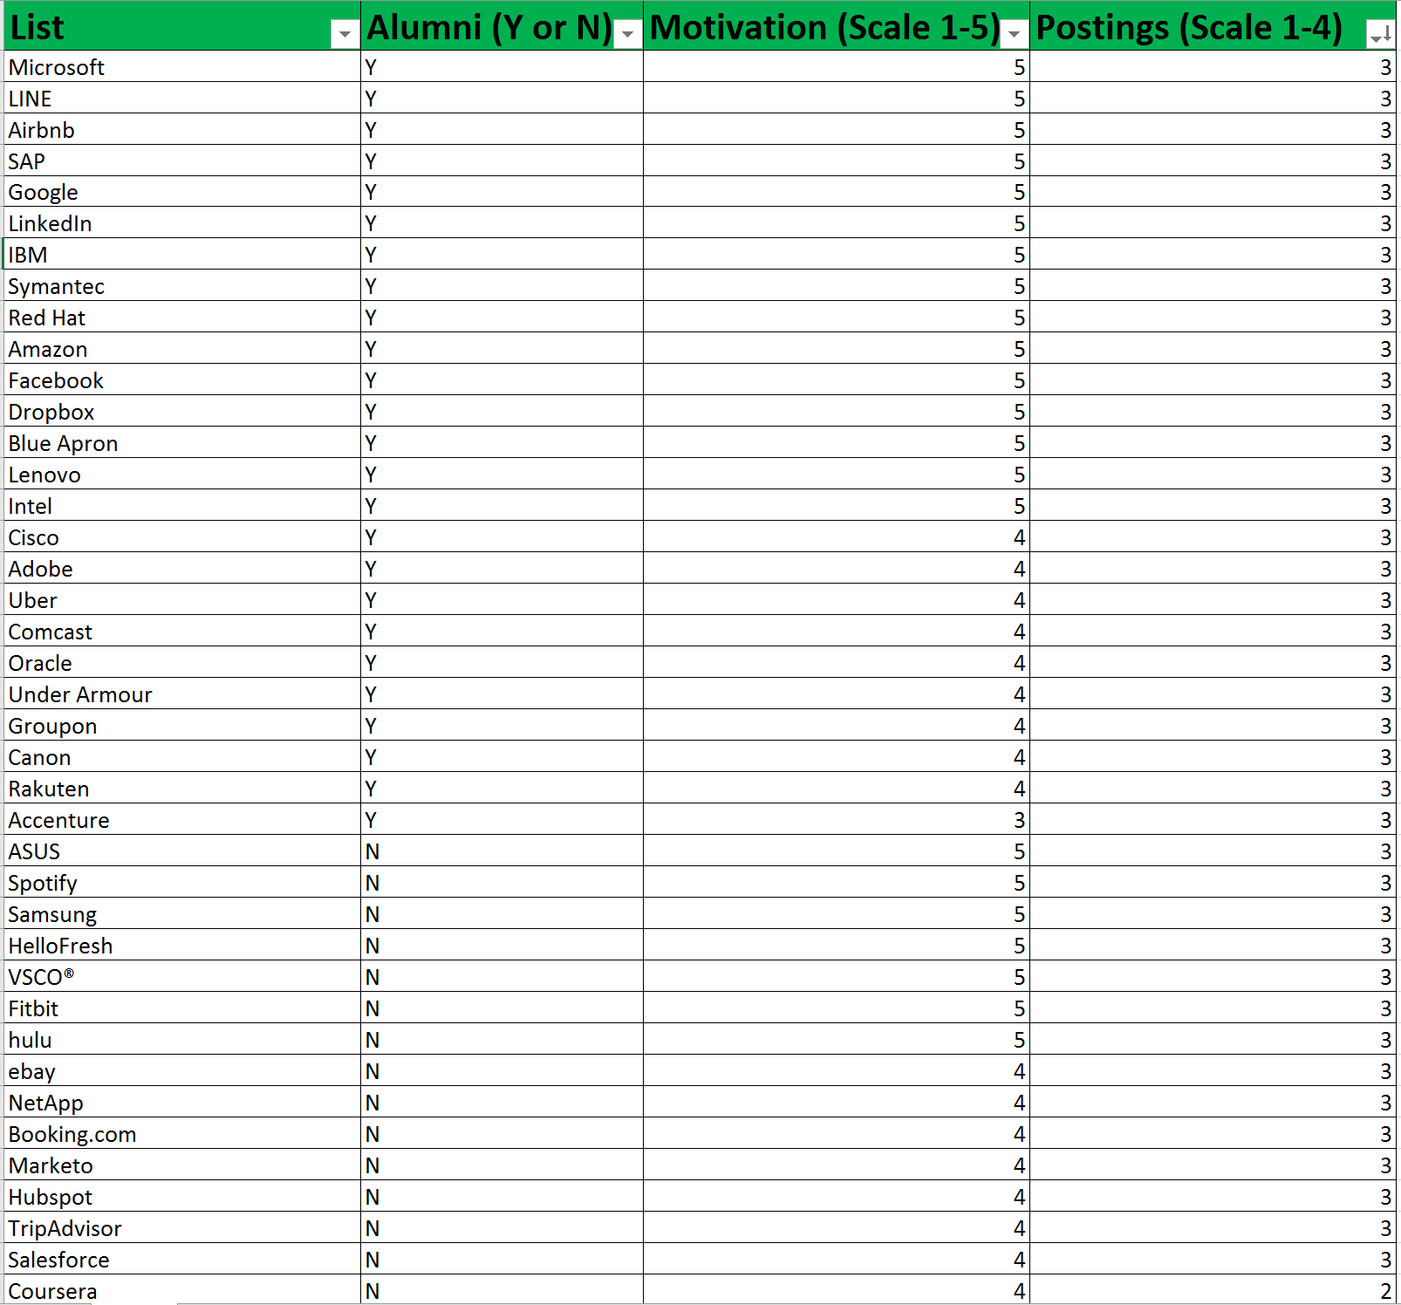
Step 1 Goal: Prioritized List
70 min
LAMP Method:
L List (Column A)
A Alumni (Column B)
M Motivation (Column C)
P Postings (Column D)
40 Companies
Excel Spreadsheet

Slide 6
List (Column A)
Dream employers
What are common traits shared by your dream employer?
Use the “similar” button in LinkedIn
Alumni approach
Use LinkedIn to find alumni with relevant job titles/positions/geographic location
Alumni can be anyone who can help: college alumni, from prior employers, social groups
Posting approach (indeed.com)
Trend-following approach
No double clicking! Capture the company and move on
40 min
40 Companies in 40 minutes
Notes:
LinkedIn’s Similar function is basically an expanded version of LinkedIn’s “People Also Viewed” section on any company’s LI page. “People Also Viewed” is great (you can find it on the lower right hand side of the page), but only six employers are displayed, and they’re only displayed as logos, making copying-and-pasting impossible. The Similar button, on the other hand, produces a list of fifty similar organizations rather than six (and in text rather than logos, making a copy-paste operation more feasible), but locating that button is tricky.
To find it, enter the company you’re trying to identify competitors of in the search bar at the top (called “Search for people, jobs, companies, and more…”). A list of options will auto-complete underneath as you type, but do not click on any of those. Simply hit “Enter” to get all results once you’re done typing.
Your dream employer will show up in this list. (If not, change the top search field’s dropdown category from “All” to “Companies.”) Again, do not click on this employer’s name once you find it — just look at its bottom row of info. When applicable, the number of people in your network who work there will appear, and to the right of that will be a link called “Similar.” That’s the one we want.
Click on it, and that list of 50 similar employers will appear. Not all of this will be similar in industry or location, but those results can be specified in the lower left-hand corner (premium LinkedIn membership is required for some; I only have basic, myself). Though the results are not perfect, they are a helpful and fast way to populate a LAMP list in industries or cities where you’re not already familiar. Simply start with your favorite target employer, pull up its Similar list, and build your list from there!

Slide 7
Alumni (Column B)
For each company, identify alumni (school, prior company’s, social groups) that work there.
Use LinkedIn to search for “alumni”
Type “Y” if you identify someone with these common links
Type “N” if you do not
You don’t have to know these “alumni”. Ideally you would like to find a common link
Don’t get caught up in capturing additional info, it can be non-productive.
10 min
ID People with common ties in 10 minutes

Slide 8
Motivation (Column C)
Score each employer on a scale from 1-5
5 = highly motivated (“dream employers”)
2 = employers you are familiar with, but least preferred
1 = completely unfamiliar
Efficiency is key-don’t spend time researching companies
Score your favorite company a 5, and score others based off of your favorite (arbitrary coherence)
5 min
Your Gut Priority in 5 minutes

Slide 9
Postings (Column D)
Indeed.com, LinkedIn, Glassdoor-search for job postings at your target company
Score each company on a scale of 1-4
1 = no job postings. Period.
2 = job postings, but not in your field of interest
3 = job postings, in your field of interest
4 = job postings, in your field of interest, and highly desirable
NO double clicking! Read the postings later
15 min
Gauge Hiring Activity in 15 minutes

Slide 10
Step 1 Goal: Prioritized List
LAMP List Sort:
1. Motivation, 5’s on top
2. Postings, 4’s on top
3. Alumni, Y on top
Complete in 70 minutes!

Slide 11
Step 2: Contacts
50 min
Curmudgeon
Don’t respond, don’t help
Obligates
Respond but don’t help
Boosters
Respond and help
Goal: Identify and secure conversations with potential advocates at top 5 target companies as efficiently and effectively as possible. From those conversations, identify Boosters and cultivate a relationship

Slide 12
Naturalize
20 min
Identify contacts for top 5 companies in your LAMP list
Convert “N” to “Y”:
LinkedIn
Facebook
Fan Mail
Linked in back solving
Cold calls
“Alumni” can be considered anyone in a position to help
Create Contacts at Top 5 Companies in 20 minutes

Slide 13
Email
Rely on Social norms vs market norms.
Simple, honest request for a favor
Find email addresses www.emails4corporations
5 point email.
Fewer than 100 words
No mention of jobs anywhere ( subject or body)
Connection goes first
Generalize your interest
Maintain control of follow up
20 min
Send a 5 point email to one contact per Top 5 company 20 minutes

Slide 14
5 point Email example
Subject: Duke MBA student seeking your advice
Dear Mr Jones,
My name is Brooke Franklin, and I am a first year Duke MBA student who found your information in LinkedIn. May I have 20 minutes to ask you about your experience with IBM? I am trying to learn more about marketing careers at technology companies in North Caroline, and your insights would be very helpful.
I recognize this may be a busy time for you, so if we are unable to connect by email I’ll try to reach you next week to see if that is more convenient.
Thank you for your time,
Brooke
Additional 5 point email examples available
See resources noted on last slide
Send a 5 point email to one contact per Top 5 company 20 minutes

Slide 15
Track
3B7 Routine
Set two reminders in your calendar when a 5-Point email is sent
Reminder #1: three business days later
Reminder #2: seven business days later
Response received before reminder #1 pops up, you may have a Booster. Schedule informational interview within 24 hrs.
If no response is received before reminder #1 (3 business days), initiate outreach to a second contact at that target company
Initiate contact with new target employers beyond Top 5 whenever Booster has been identified, or employer ruled out, or time permits
Do not take on more companies than allows you to maintain the 3B7 routine and timing
10min
Establish 3B7 tracking on calendar 10 minutes

Slide 16
Your Job Search system is in place!
“Within that 2-hour period, I’d create a 40-employer target list sorted into a precise order of attack based on easy-to-find data, draft an effective outreach e-mail template, identify the most promising starting contact at each of my Top 5 employers, and sent my first batch of informational interview requests out. Further effort beyond that would serve only to exhaust me, since the bottleneck in the job search process is not work ethic but the speed at which potential advocates respond.” Steve Dalton
120 minutes!

Slide 17
Step 3: Recruit
They said yes! What is next?
TIARA Framework
Research
Follow-up

Slide 18
Research
Conduct External Research, 15 min for 30 min conversation
SWOT Analysis (Hoovers, Data Monitor, Vault, Wet Feet)
Review company news on website, know their good news
LinkedIn newsfeed
Identify any negative news about contact and/or company. Be aware, don’t initiate conversations about their bad news.
Contact’s LinkedIn profile, company bio, articles, etc.
Be prepared for “Big 3” questions:
Tell me about yourself?
Why are you interested in our company?
Why are you interested in our industry and/or function?

Slide 19
Informational Interview
Phase 1: Small Talk
Express gratitude
“How is your day going so far?”
“What projects are you working on?”
“ I would like to hear more about your background. How did you come into your current position?”
Phase 2: What is the TIARA Framework?
Trends
Insights
Advice
Resources
Assignments
Phase 3: Next Steps (“Who else do you recommend I speak with?”)
Example questions for each TIARA step available
See resources noted on last slide

Slide 20
Follow up Communications
Send a “Thank you” email within 24 hours
Schedule monthly reminders to follow-up with those contacts with whom you’ve conducted informational interviews
First update email: recap advice they gave you, how you benefited/gained from it, and request additional suggestions
Further updates serve to share your progress and request any additional suggestions
Sample thank you notes available
See resources noted on last slide

Slide 21
The Two Hour Job Search
www.2hourjobsearch.com
Linked in Group: The 2-Hour Job Search - Q&A Forum
Twitter @Dalton_Steve
YouTube: Steve Dalton or 2-Hour Job Search
https://www.huffingtonpost.com/author/steve-dalton http://touchmba.com/steve-dalton-the-2-hour-job-search/
Free on Audible
Amazon paperback $11.04

Slide 22
Finding “Similar” in Linked in
LinkedIn’s Similar function is basically an expanded version of LinkedIn’s “People Also Viewed” section on any company’s LI page. “People Also Viewed” is great (you can find it on the lower right hand side of the page), but only six employers are displayed, and they’re only displayed as logos, making copying-and-pasting impossible. The Similar button, on the other hand, produces a list of fifty similar organizations rather than six (and in text rather than logos, making a copy-paste operation more feasible), but locating that button is tricky.
To find it, enter the company you’re trying to identify competitors of in the search bar at the top (called “Search for people, jobs, companies, and more…”). A list of options will auto-complete underneath as you type, but do not click on any of those. Simply hit “Enter” to get all results once you’re done typing.
Your dream employer will show up in this list. (If not, change the top search field’s dropdown category from “All” to “Companies.”) Again, do not click on this employer’s name once you find it — just look at its bottom row of info. When applicable, the number of people in your network who work there will appear, and to the right of that will be a link called “Similar.” That’s the one we want.
Click on it, and that list of 50 similar employers will appear. Not all of this will be similar in industry or location, but those results can be specified in the lower left-hand corner (premium LinkedIn membership is required for some; I only have basic, myself). Though the results are not perfect, they are a helpful and fast way to populate a LAMP list in industries or cities where you’re not already familiar. Simply start with your favorite target employer, pull up its Similar list, and build your list from there!

